Slide 1
Logistic Regression
Geoff Hulten

Slide 2
Overview of Logistic Regression
A linear model for classification and probability estimation.
Can be very effective when:
  The problem is linearly separable
  Or there are a lot of relevant features (10s - 100s of thousands can work)
  You need an efficient runtime
  You want a simple, effective baseline
Logistic regression will generally not be the most accurate option, but it is used a lot in practice.

Slide 3
Components of Learning Algorithm:
Logistic Regression
Model Structure –
Linear model with sigmoid activation
Loss Function –
Log Loss
Optimization Method –
Gradient Descent

Slide 4
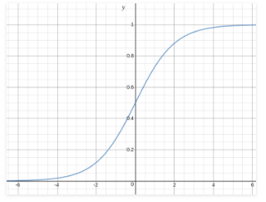

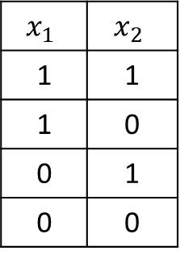
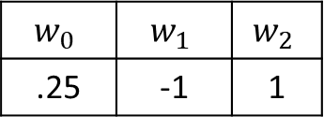
Structure of Logistic Regression
Bias Weight
Weight per Feature
Linear Model: $w_{0}+ \sum_{i}^{n}{w_{i} ∗ x_{i}}$
$\hat{y}=sigmoid(w_{0}+ \sum_{i}^{n}{w_{i} ∗ x_{i})}$
$sigmoid\left(z\right)= \frac{1}{1+ e^{−z}}$
Predict 1
Threshold = .9
Predict 0
Threshold = .5
Example:
$$w_{0}$$ | $$w_{1}$$ | $$w_{2}$$
.25 | -1 | 1
$$x_{1}$$ | $$x_{2}$$
1 | 1
1 | 0
0 | 1
0 | 0

Slide 5
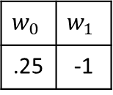
Visual Example of Logistic Regression Model
Visualize Data with Just one Feature
Predict 1
Predict 0
Map Back
Model
$$w_{0}$$ | $$w_{1}$$
.25 | -1
Apply Model
Apply Sigmoid

Slide 6
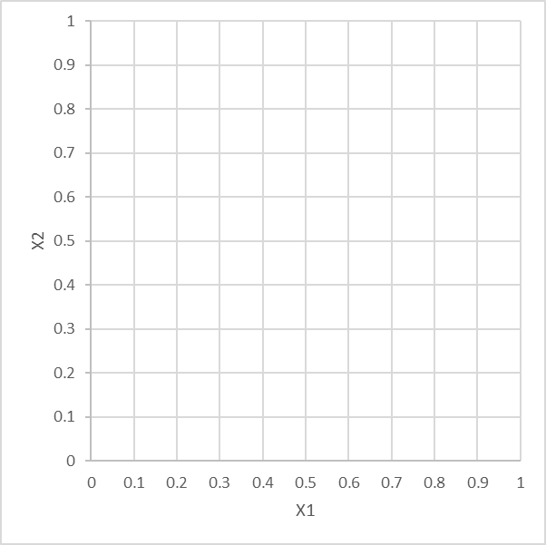
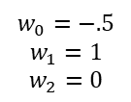
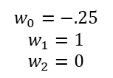

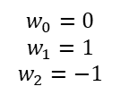
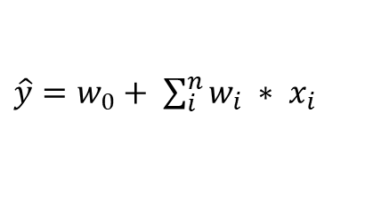
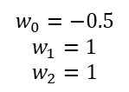
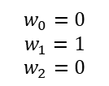
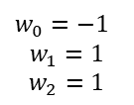
Examples of Linear Models
$\hat{y}=w_{0}+ \sum_{i}^{n}{w_{i} ∗ x_{i}}$
$$w_{0}=0$$
$$w_{1}=1$$
$$w_{2}=0$$
$$w_{0}=−.25$$
$$w_{1}=1$$
$$w_{2}=0$$
$$w_{0}=−.5$$
$$w_{1}=1$$
$$w_{2}=0$$
$$\hat{y}<0$$
$$\hat{y}>0$$
2-Dimensions: Line
3-Dimension: Plane
N-Dimension: Hyperplane
Curse of Dimensionality
- Sparsity
- Closeness
$$w_{0}=−0.5$$
$$w_{1}=1$$
$$w_{2}=1$$
$w_{0}=−$1
$$w_{1}=1$$
$$w_{2}=1$$
$$w_{0}=0$$
$$w_{1}=1$$
$$w_{2}=−1$$

Slide 7
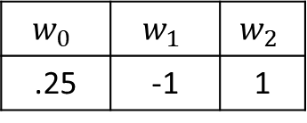
Intuition about linear models
Higher Threshold
3 Dimensions
Decision surface is plane
N-Dimensions
Decision surface is n-dimensional hyper-plane
High-dimensions are weird
High-dimensional hyper-planes can represent quite a lot
Predict 1
$$w_{0}$$ | $$w_{1}$$ | $$w_{2}$$
.25 | -1 | 1
Predict 0
Lower Threshold

Slide 8

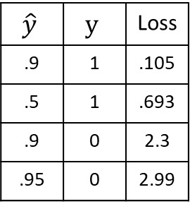
Loss Function: Log Loss
$\hat{y}$ -- The predicted $y$ (pre-threshold)
Log Loss:
  If $y$ is 1: $−log⁡(\hat{y})$
  If $y$ is 0: $−log⁡(1 −\hat{y})$
Examples
$$\hat{y}$$ | $$y$$ | Loss
.9 | 1 | .105
.5 | 1 | .693
.9 | 0 | 2.3
.95 | 0 | 2.99
Use Natural Log (base e)

Slide 9


Logistic Regression Loss Function Summary
Log Loss
$$Loss\left(\hat{y},y\right)=−log\left(\hat{y}\right) If y=1$$
$$Loss\left(\hat{y},y\right)=−log\left(1 −\hat{y}\right) If y=0$$
Same thing expressed in Sneaky Math
$$Loss\left(\hat{y}, y\right)=−y ∗\log\left(\hat{y}\right)−\left(1 −y\right)∗log(1 −\hat{y})$$
Average across the data set
$$Loss\left(dataSet\right)=\frac{1}{n}\sum_{j}^{n}{Loss(\hat{y_{j}},y_{j})}$$
$\hat{y}$ is pre-thresholding
Use natural log (base e)

Slide 10
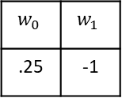
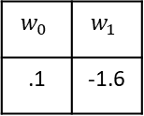
Logistic Regression Optimization:
Gradient Descent
Predict 1
Predict 0
$$w_{0}$$ | $$w_{1}$$
.25 | -1
‘Initial’ Model
Training Set
$$w_{0}$$ | $$w_{1}$$
.1 | -1.6
Updated Model

Slide 11


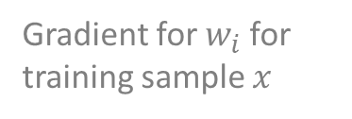
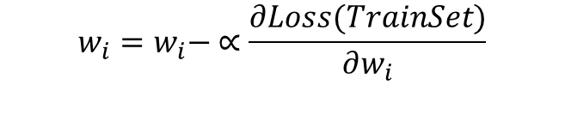



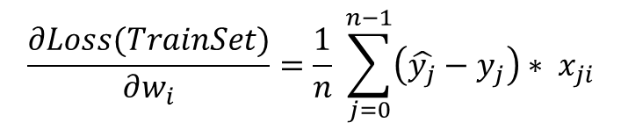

Finding the Gradient
Derivative of Loss Function with respect to model weights
$$\frac{dLoss(x)}{dθ}$$
$$→ \frac{∂Loss(x)}{∂w_{i}}$$
Gradient for $w_{i}$ for training sample $x$
$$=\left(\hat{y}−y\right)∗x_{i}$$
$$= …$$
Model Parameters
(all the w’s)
Partial Derivative per weight
Calculus you don’t need to remember
$$\frac{∂Loss(TrainSet)}{∂w_{i}}=\frac{1}{n} \sum_{j=0}^{n−1}{\left(\hat{y_{j}}−y_{j}\right)∗ x_{ji}}$$
Average across training data set
Compute simultaneously for all $w_{i}$ with one pass over data
Update each weight by stepping away from gradient
$$w_{i}=w_{i}− ∝\frac{∂Loss(TrainSet)}{∂w_{i}}$$
Note: $x_{0}=1.0$ for all samples

Slide 12
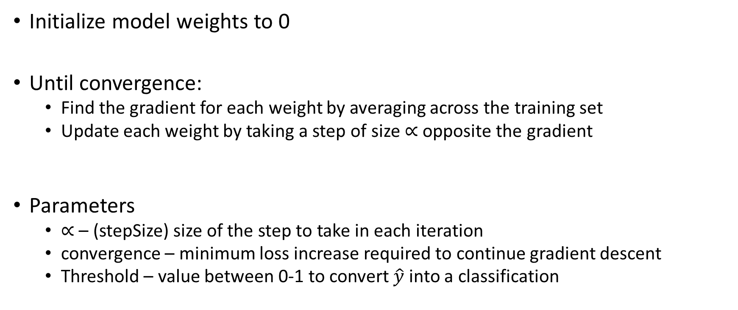
Logistic Regression Optimization Algorithm
Initialize model weights to 0
Until convergence:
  Find the gradient for each weight by averaging across the training set
  Update each weight by taking a step of size $∝$ opposite the gradient
Parameters
  $∝$ – (stepSize) size of the step to take in each iteration
  convergence – minimum loss increase required to continue gradient descent
  Threshold – value between 0-1 to convert $\hat{y}$ into a classification

