Slide 1
Feature Engineering
Geoff Hulten

Slide 2
Overview
Feature engineering overview
Common approaches to featurizing with text
Iterating and improving (and dealing with mistakes)

Slide 3
Goals of Feature Engineering
Convert unstructured data into input to learning algorithm.
Expose the structure of the concept to the learning algorithm.
Work well with the structure of the model the algorithm will create.
Balance number of features, complexity of concept, complexity of model, amount of data.

Slide 4
Sample from SMS Spam
SMS Message (arbitrary text) -> 5 dimensional array of binary features
1 if message is longer than 40 chars, 0 otherwise
1 if message contains a digit, 0 otherwise
1 if message contains word ‘call’, 0 otherwise
1 if message contains word ‘to’, 0 otherwise
1 if message contains word ‘your’, 0 otherwise
“SIX chances to win CASH! From 100 to 20,000 pounds txt> CSH11 and send to 87575. Cost 150p/day, 6days, 16+ TsandCs apply Reply HL 4 info”
Long? | HasDigit? | ContainsWord(Call) | ContainsWord(to) | ContainsWord(your)
1
1
0
1
0

Slide 5
Basic Feature Types
Binary Features
ContainsWord(call)?
IsLongSMSMessage?
Contains(*#)?
ContainsPunctuation?
Categorical Features
FirstWordPOS ->
  { Verb, Noun, Other }
MessageLength ->
  { Short, Medium, Long, VeryLong }
TokenType ->
  { Number, URL, Word, Phone#, Unknown }
GrammarAnalysis ->
  { Fragment, SimpleSentence, ComplexSentence }
Numeric Features
CountOfWord(call)
MessageLength
FirstNumberInMessage
WritingGradeLevel

Slide 6
Converting Between Feature Types
Single threshold
Numeric Feature => Binary Feature
  Length of text + [ 40 ] => { 0, 1 }
Numeric Feature => Categorical Feature
  Length of text + [ 20, 40 ] => { short or medium or long }
Categorical Feature => Binary Features
  { short or medium or long } => [ 1, 0, 0] or [ 0, 1, 0] or [0, 0, 1]
Binary Feature => Numeric Feature
  { 0, 1 } => { 0, 1 }
Set of thresholds
One-hot encoding
…

Slide 7
Sources of Data for Features
System State
  App in foreground?
  Roaming?
  Sensor readings
Content Analysis
  Stuff we’ve been talking about
  Stuff we’re going to talk about next
User Information
  Industry
  Demographics
Interaction History
  User’s ‘report as junk’ rate
  # previous interactions with sender
  # messages sent/received
Metadata
  Properties of phone #s referenced
  Properties of the sender
  Run other models on the content
    Grammar
    Language
    …
Notes:
NOTE: this might go better in some machine learning engineering section…like maybe in ‘approaching a ML problem’ or something…

Slide 8
Feature Engineering for Text
Tokenizing
Bag of Words
N-grams
TF-IDF
Embeddings
NLP

Slide 9
Tokenizing
Breaking text into words
  “Nah, I don't think he goes to usf” ->
  [ ‘Nah,’ ‘I’, ‘don't’, ‘think’, ‘he’, ‘goes’, ‘to’, ‘usf’ ]
Dealing with punctuation
  “Nah,” ->
  [ ‘Nah,’ ] or [ ‘Nah’, ‘,’ ] or [ ‘Nah’ ]
  “don't” ->
  [ ‘don't’ ] or [ ‘don’, ‘'’, ‘t’ ] or [ ‘don’, ‘t’ ] or [ ‘do’, ‘n't’ ]
Normalizing
  “Nah,” ->
    [ ‘Nah,’ ] or [ ‘nah,’ ]
  “1452” ->
    [ ‘1452’ ] or [ <number> ]
Some tips for deciding
If you have lots of data / optimization…
  Keep as much information as possible
  Let the learning algorithm figure out what is important and what isn’t
If you don’t have much data / optimization...
  Reduce the number of features you maintain
  Normalize away irrelevant things
Focus on things relevant to the concept…
  Explore data / use your intuition
  Overfitting / underfitting ← much more later

Slide 10
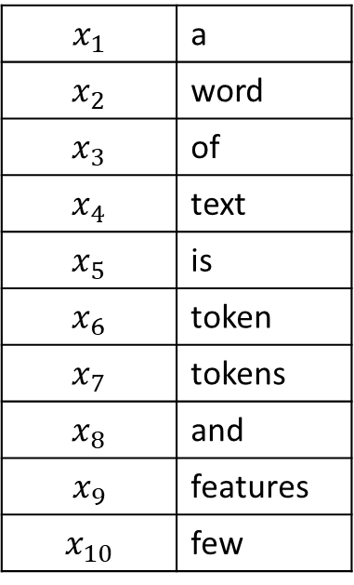
Bag of Words
One feature per unique token
Bag of words
word
of
$$x_{1}$$ | a
$$x_{2}$$ | word
$$x_{3}$$ | of
$$x_{4}$$ | text
$$x_{5}$$ | is
$$x_{6}$$ | token
$$x_{7}$$ | tokens
$$x_{8}$$ | and
$$x_{9}$$ | features
$$x_{10}$$ | few
text
a
m1:
m2:
m3:
m4:
A word of text.
A word is a token.
Tokens and features.
Few features of text.
word
is
a
a
token
features
tokens
and
few
features
of
text
Training data
Tokens
Features

Slide 11
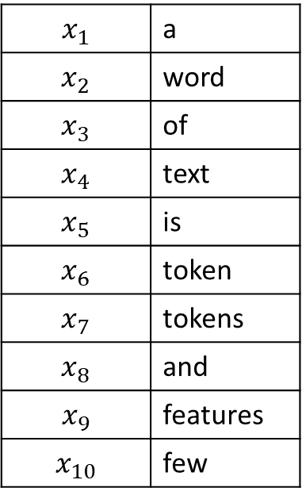
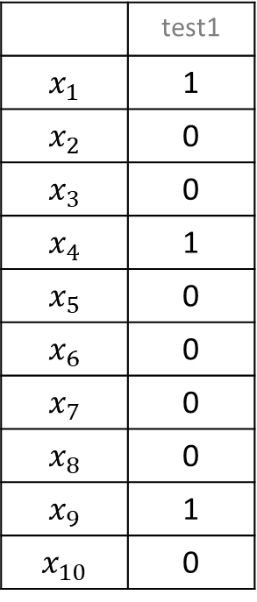
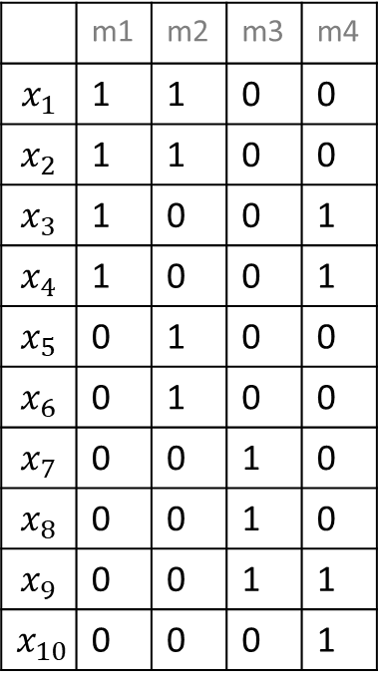
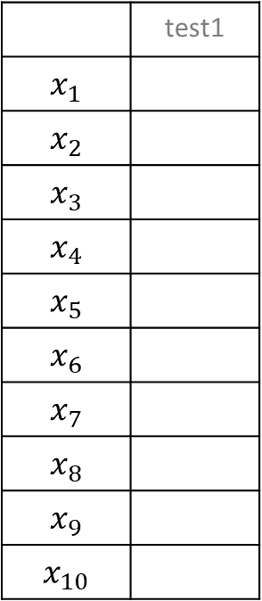
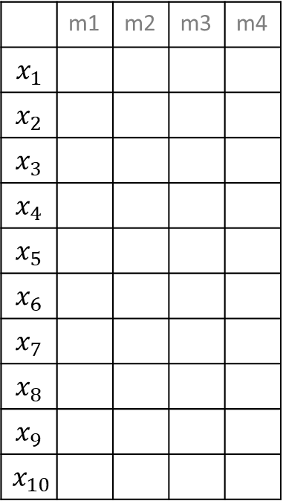
Bag of Words: Example
test1: Some features for a text example.
 | m1 | m2 | m3 | m4
$$x_{1}$$
$$x_{2}$$
$$x_{3}$$
$$x_{4}$$
$$x_{5}$$
$$x_{6}$$
$$x_{7}$$
$$x_{8}$$
$$x_{9}$$
$$x_{10}$$
 | test1
$$x_{1}$$
$$x_{2}$$
$$x_{3}$$
$$x_{4}$$
$$x_{5}$$
$$x_{6}$$
$$x_{7}$$
$$x_{8}$$
$$x_{9}$$
$$x_{10}$$
 | m1 | m2 | m3 | m4
$$x_{1}$$ | 1 | 1 | 0 | 0
$$x_{2}$$ | 1 | 1 | 0 | 0
$$x_{3}$$ | 1 | 0 | 0 | 1
$$x_{4}$$ | 1 | 0 | 0 | 1
$$x_{5}$$ | 0 | 1 | 0 | 0
$$x_{6}$$ | 0 | 1 | 0 | 0
$$x_{7}$$ | 0 | 0 | 1 | 0
$$x_{8}$$ | 0 | 0 | 1 | 0
$$x_{9}$$ | 0 | 0 | 1 | 1
$$x_{10}$$ | 0 | 0 | 0 | 1
 | test1
$$x_{1}$$ | 1
$$x_{2}$$ | 0
$$x_{3}$$ | 0
$$x_{4}$$ | 1
$$x_{5}$$ | 0
$$x_{6}$$ | 0
$$x_{7}$$ | 0
$$x_{8}$$ | 0
$$x_{9}$$ | 1
$$x_{10}$$ | 0
Out of
vocabulary
$$x_{1}$$ | a
$$x_{2}$$ | word
$$x_{3}$$ | of
$$x_{4}$$ | text
$$x_{5}$$ | is
$$x_{6}$$ | token
$$x_{7}$$ | tokens
$$x_{8}$$ | and
$$x_{9}$$ | features
$$x_{10}$$ | few
m1:
m2:
m3:
m4:
A word of text.
A word is a token.
Tokens and features.
Few features of text.
Selected Features
Training X
Test X
Use bag of words when you have a lot of data, can use many features

Slide 12
N-Grams: Tokens
Instead of using single tokens as features, use series of N tokens
“down the bank” vs “from the bank”
Message 1: “Nah I don't think he goes to usf”
Message 2: “Text FA to 87121 to receive entry”
Nah I | I don’t | don’t think | think he | he goes | goes to | to usf | … | Text FA | FA to | 87121 to | To receive | receive entry
0 | 0 | 0 | 0 | 0 | 0 | 0 | … | 1 | 1 | 1 | 1 | 1
Message 2:
Use when you have a LOT of data, can use MANY features

Slide 13
N-Grams: Characters
Instead of using series of tokens, use series of characters
Message 1: “Nah I don't think he goes to usf”
Message 2: “Text FA to 87121 to receive entry”
Na | ah | h <space> | <space> I | I <space> | <space> d | do | … | <space> e | en | nt | tr | ry
0 | 0 | 0 | 0 | 0 | 0 | 0 | … | 1 | 1 | 1 | 1 | 1
Message 2:
Helps with out of dictionary words & spelling errors
Fixed number of features for given N (but can be very large)

Slide 14
TF-IDF
Term Frequency – Inverse Document Frequency
Instead of using binary: ContainsWord(<term>)
Use numeric importance score TF-IDF:
  TermFrequency(<term>, <document>) =
      % of the words in <document> that are <term>
  InverseDocumentFrequency(<term>, <documents>) =
      log ( # documents / # documents that contain <term> )
Importance to
Document
Novelty across
corpus
Words that occur in many documents have low score ($x_{i}$)
Message 1: “Nah I don't think he goes to usf”
Message 2: “Text FA to 87121 to receive entry”
 | Nah | I | don't | think | he | goes | to | usf | Text | FA | 87121 | receive | entry
BOW | 0 | 0 | 0 | 0 | 0 | 0 | 1 | 0 | 1 | 1 | 1 | 1 | 1
TF-IDF | 0 | 0 | 0 | 0 | 0 | 0 | 0 | 0 | .099 | .099 | .099 | .099 | .099
Message 2:

Slide 15
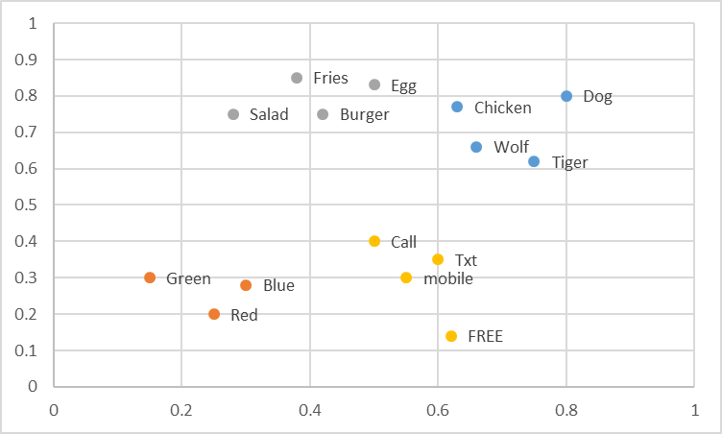
Embeddings -- Word2Vec and FastText
Word -> Coordinate in N dimension
Regions of space contain similar concepts
Creating Features Options:
  Average vector across words
  Count in specific regions
Commonly used with neural networks
Replaces words with their ‘meanings’ – sparse -> dense representation

Slide 16
Normalization (Numeric => Better Numeric)
Helps make model’s job easier
  No need to learn what is ‘big’ or ‘small’ for the feature
  Some model types benefit more than others
To use in practice:
  Estimate mean/stdev on training data
  Apply normalization using those parameters to:
  train / validate / test
Raw X
Normalize
Mean
Normalize
Variance
36
74
22
81
105
113
77
91
-38.875
-0.875
-52.875
6.125
30.125
38.125
2.125
16.125
-1.31696
-0.02964
-1.79123
0.207495
1.020536
1.29155
0.071988
0.546262
Subtract
Mean
Divide by
Stdev
Mean: 74.875
Mean: 0
Mean: 0
Std: 29.5188
Std: 1

Slide 17
Understanding Mistakes
Noise in the data
  Encodings
  Bugs
  Missing values
  Corruption
Noise in the labels
  Ham: As per your request 'Melle Melle (Oru Minnaminunginte Nurungu Vettam)' has been set as your callertune for all Callers. Press *9 to copy your friends Callertune
  Spam: I’ll meet you at the restaurant between 10 & 10:30 – can’t wait!
Model being wrong…
  Feature engineering
  And lots of other things we’ll talk about…

Slide 18
Exploring Mistakes
Examine N random false positive and N random false negatives
Examine N worst false positives and N worst false negatives
  Model predicts very near 1, but true answer is 0
  Model predicts very near 0, but true answer is 1
Reason | Count
Label Noise | 2
Slang | 5
Non-English | 5
… | …
Notes:
NOTE: might talk about being careful about cheating by seeing specific validation mistakes and fixing them, but not in a way that will generalize.

Slide 19
Approach to Feature Engineering
Start with ‘standard’ for your domain; 1 parameter per ~10 samples
Try all the important variations evaluate on the validation set
  Tokenizing
  Bag of words
  N-grams
  …
Look at your mistakes…
Use your intuition about your domain and adapt standard approaches or invent new features…
Iterate
When you want to know how well you did, evaluate on test data
And do feature selection (next lecture)

Slide 20
Feature Engineering in Other Domains
Computer Vision:
Gradients
Histograms
Convolutions
Time Series:
Window aggregated statistics
Frequency domain transformations
Internet:
IP Parts
Domains
Relationships
Reputation
Neural Networks:
A whole bunch of other things we’ll talk about later…

Slide 21
Summary of Feature Engineering
Feature engineering converts raw context (unstructured data) into inputs for machine learning
Goals are:
  Match structure of concept to structure of model representation
  Balance number of feature, amount of data, complexity of concept, power of model
Every domain has a library of proven feature engineering approaches
Text’s include: normalization, tokenizing, n-grams, TF-IDF, embeddings, & NLP

