Slide 1
Feature Selection
Geoff Hulten

Slide 2
Feature Selection
Feature engineering techniques can create many features
Having too many features can cause problems:
  Slowing down the modeling process
  Using more RAM
  Confusing the optimization process (e.g. overfitting)
Feature selection algorithms:
  Estimate the quality of features
  Use only the best features when building models
Approaches:
  Frequency
  Mutual Information
  Accuracy (wrapper)

Slide 3
Simple Feature Engineering Pattern
Input for machine learning model at runtime
runtimeXRaw
trainXRaw
Modeling
Process
Model
Featurize
runtimeX
trainY
Feature Creation
Process
Featurization Parameters
Selected words / n-grams and their feature indexes
Raw data to choose which features to use
Info needed to turn raw context into features
TF-IDF weights to use for each word
Normalization parameters for numeric features: means and stdevs

Slide 4
Feature Selection: Frequency
Take top N most common features in the training set
featurizer = SMSSpamFeaturize.SMSSpamFeaturize()
featurizer.CreateVocabulary(xTrainRaw, yTrain, numFrequentWords = 4)
xTrain = featurizer.Featurize(xTrainRaw)
xValidate = featurizer.Featurize(xValidateRaw)
xTest = featurizer.Featurize(xTestRaw)

Slide 5
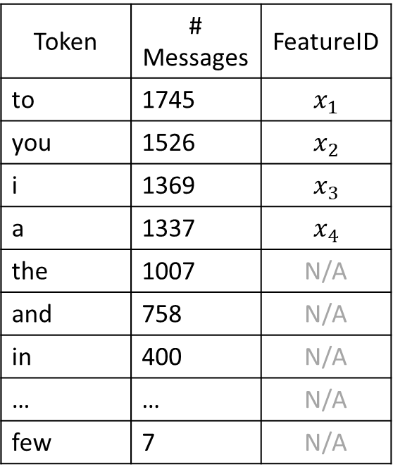
Feature Selection: Frequency
featurizer.CreateVocabulary(xTrainRaw, yTrain, numFrequentWords = 4)
Token | # Messages
to | 1745
you | 1526
i | 1369
a | 1337
the | 1007
and | 758
in | 400
… | …
few | 7
Token | # Messages | FeatureID
to | 1745 | $$x_{1}$$
you | 1526 | $$x_{2}$$
i | 1369 | $$x_{3}$$
a | 1337 | $$x_{4}$$
the | 1007 | N/A
and | 758 | N/A
in | 400 | N/A
… | … | N/A
few | 7 | N/A
Token | # Messages
the | 1007
in | 400
a | 1337
i | 1369
to | 1745
and | 758
you | 1526
…
few | 7
Represent as…
List of (<token>, <id>)
Mapping[<inputID>] -> <outputID>
Bag of words
Sort by frequency

Slide 6
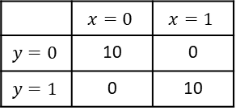
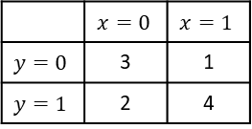

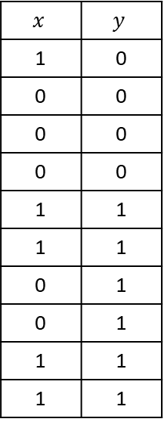
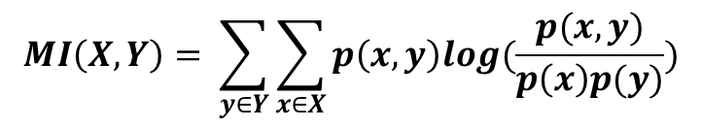


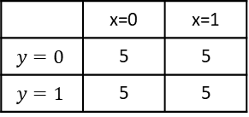
Feature Selection: Mutual Information
Correlation:
Strength of linear relationship between variables.
Mutual Information:
How much you learn about one variable by knowing the value of the other variable.
Take N that contain most information about the value of Y on the training set
$$MI\left(X,Y\right)= \sum_{y∈Y}{\sum_{x∈X}{p\left(x,y\right)log(\frac{p(x,y)}{p\left(x\right)p(y)})}}$$
$$x$$ | $$y$$
1 | 0
0 | 0
0 | 0
0 | 0
1 | 1
1 | 1
0 | 1
0 | 1
1 | 1
1 | 1
$$p\left(x=0,y=0\right)log\left(\frac{p\left(x=0,y=0\right)}{p\left(x=0\right)p\left(y=0\right)}\right)$$
$$= .3 ∗log\left(\frac{.3}{.5 ∗ .4}\right)=0.122$$
 | $$x=0$$ | $$x=1$$
$$y=0$$ | 3 | 1
$$y=1$$ | 2 | 4
Sum over all combinations: MI = 0.086
Contingency
Table
 | $$x=0$$ | $$x=1$$
$$y=0$$ | 10 | 0
$$y=1$$ | 0 | 10
Perfect predictor → high MI
 | x=0 | x=1
$$y=0$$ | 5 | 5
$$y=1$$ | 5 | 5
Training Data
No Information → 0 MI
Additive Smoothing to avoid 0s: $P\left(∗\right)= \frac{Obs\left(∗\right)+1}{N+2}$
Notes:
Log(1) = 0
Log(2) ~ .3

Slide 7
Feature Selection: Accuracy (wrapper)
Take N that improve accuracy most on hold out data
Similar information, low accuracy gain
1 feature
Example: 2 features
Greedy search, adding or removing features
  From baseline, try adding (removing) each candidate
  Build a model
  Evaluate on hold out data
  Add (remove) the best
  Repeat till you get to N
Optimizes for the:
  Labels
  Modeling process
Token | MI
to | .3
you | .29
i | .28
a | .28
the | .1
and | .1
in | .1
… | …
few | .001
Step 1
77.2%
77.0%
76.8%
76.5%
61.2%
60.6%
60.1%
…
52.8%
Step 2
<in model>
77.4%
77.3%
77.2%
80.2%
79.4%
78.3%
…
77.2%

Slide 8
Previous Model Evaluation Pattern
for p in hyperparametersToTry:
model.fit(xTrain, yTrain, p)
accuracies[p] = evaluate(yValidation, model.predict(xValidation))
bestHyperparameters = accuracies(d, key=lambda key: accuracies[key])
finalModel.fit(xTrain + xValidation, yTrain + yValidation, bestHyperparameters)
estimateOfGeneralizationPerformance = evaluate(yTest, finalModel.predict(xTest))

Slide 9
Simple Feature Selection Pattern
for f in featureCreationParametersToTry:
featurizer = SMSSpamFeaturize.SMSSpamFeaturize()
featurizer.CreateVocabulary(xTrainRaw, yTrain, f)
xTrain = featurizer.Featurize(xTrainRaw)
xValidation = featurizer.Featurize(xValidationRaw)
  for p in hyperparametersToTry:
  model.fit(xTrain, yTrain, p)
  accuracies[(p, f)] = evaluate(yValidation, model.predict(xValidation))
(bestHyperparameters, bestFeatureParameters) = accuracies(d, key=lambda key: accuracies[key])
bestFeaturizer = SMSSpamFeaturize.SMSSpamFeaturize()
bestFeaturizer.CreateVocabulary(xTrainRaw + xValidationRaw, yTrain + yValidation,
bestFeatureParameters)
# Build the final model & do all the evaluation stuff on the test set…

Slide 10
Summary of Feature Selection
Using too many features can cause problems:
  Machine Learning algorithm’s properties (e.g. overfitting)
  Amount of available data
  Training time and RAM
  Runtime implications
Feature Selection algorithms help you find the best features
Frequency takes the features that occur on the most messages
Mutual information estimates how much each features tells you about the value of the label
Accuracy wrapper estimates how valuable each feature is to the modeling process
Some hybrid method to balance speed with quality…
Notes:
The three methods are a continuum in that the first is uniformed by the task, the second uses relationship to the label in isolation, the third uses interacting with the modeling process (and previously selected features). Thus the third is much more time consuming, but could be the most accurate.

