Slide 1
ROC Curves and Operating Points
Geoff Hulten

Slide 2
Which Model should you use?
 | False Positive Rate | False Negative Rate
Model 1 | 41% | 3%
Model 2 | 5% | 25%
Mistakes have different costs:
Disease Screening – LOW FN Rate
Spam filtering – LOW FP Rate
Conservative vs Aggressive settings:
The same application might need multiple tradeoffs
Actually the same model
- different thresholds

Slide 3
Classifications and Probability Estimates
Logistic regression produces a score between 0 – 1 (probability estimate)
Use threshold to produce classification
What happens if you vary the threshold?

Slide 4
Example of Changing Thresholds
 | Threshold = .5
False Positive Rate | 33%
False Negative Rate | 0%
Score | Prediction | Y
.25 |  | 0
.45 |  | 0
.55 |  | 1
.67 |  | 0
.82 |  | 1
.95 |  | 1
 | Threshold = .6
False Positive Rate | 33%
False Negative Rate | 33%
 | Threshold = .7
False Positive Rate | 0%
False Negative Rate | 33%

Slide 5
ROC Curve
(Receiver Operating Characteristic)
Percent of 0s classified as 1
Perfect score:
0% of 1s called 0
0% of 0s called 1
This model’s distance
from perfect
Sweep threshold from 0 to 1
Threshold 0: ‘all’ classified as 1
Threshold 1: ‘all’ classified as 0
Percent of 1s classified as 0

Slide 6
Operating Points
Threshold .04
Threshold .05
Threshold .03
2) Target FN Rate
3) Explicit cost:
FP costs 10
FN costs 1
Threshold: 0.8
- 5FPs + 60FNs → 110 cost
Threshold: 0.83
- 4FPs + 65FNs → 105 cost
Interpolate between nearest measurements:
- To achieve 30% FPR, use threshold of ~0.045
Threshold: 0.87
- 3FPs + 90FNs → 120 cost
1) Target FP Rate

Slide 7
Calculating ROC curves
# A helper function for calculating FN rate and FP rate across a range of thresholds
def TabulateModelPerformanceForROC(model, xValidate, yValidate):
pointsToEvaluate = 100
thresholds = [ x / float(pointsToEvaluate) for x in range(pointsToEvaluate + 1)]
FPRs = []
FNRs = []
try:
for threshold in thresholds:
FPRs.append(EvaluateBinaryClassification.FalsePositiveRate(yValidate,
model.predict(xValidate, classificationThreshold=threshold)))
FNRs.append(EvaluateBinaryClassification.FalseNegativeRate(yValidate,
model.predict(xValidate, classificationThreshold=threshold)))
except NotImplementedError:
raise UserWarning("The 'model' parameter must support using a 'classificationThreshold’...")
return (FPRs, FNRs, thresholds)

Slide 8
Comparing Models with ROC Curves
Model 1 better than Model 2 at every FPR or FNR target
Area Under Curve (AUC)
Integrate Area under the curve
Perfect score is 1
Higher scores allow for generally better tradeoffs
AUC of 0.5 indicates model is essentially randomly guessing
AUC of < 0.5 indicates you’re doing something wrong…
Model 1 better than
Model 2 at this FNR
Model 1: AUC ~97
Model 2: AUC ~89.5
Model 1 better than Model 2 at this FPR

Slide 9
More ROC Comparisons
ROC Curves Cross
Model 1 better at low FNR
Model 2 better at low FPR
Zoom in on region of interest
Model 1: AUC ~97
Model 2: AUC ~93.5
Model 2:
Worse AUC
May be better at what you need…

Slide 10
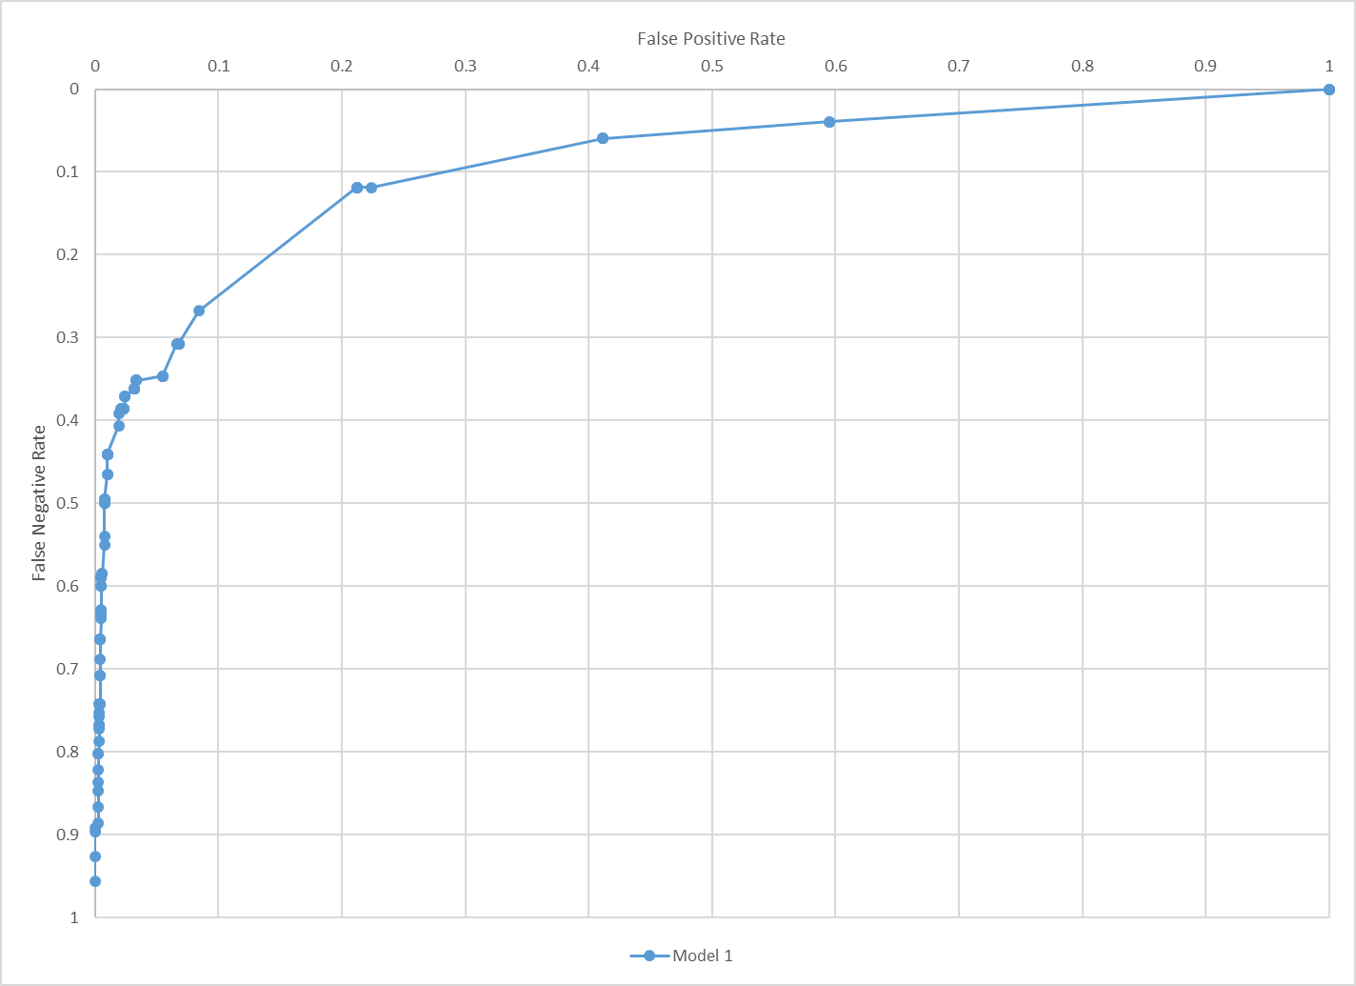
Some Common ROC Problems
Imbalanced Classes…
Different people plot them different ways…

Slide 11
Precision Recall Curves – PR Curves
Incremental Classifications More Accurate:
Threshold continuing lower
95%+ of new 1s are actually 1s
High Precision
Threshold near 1:
Everything classified as 1 is a 1
But many 1s are classified as 0
Incremental Classifications
Less Accurate:
Most new 1s are actually 0s
Low Recall
Near perfect recall:
~All 1s classified as 1s
Precision around 25%
Sliding threshold lower:
Classify a bunch of 0s as 1s
Structure indicative of a sparse,
strong feature
Threshold set to 0:
Everything Classified as 1

Slide 12
ROC Curves & Operating Points Summary
Adapt tradeoff between types of mistakes by varying the threshold used to turn probabilities (scores) into classifications
ROC curves allow:
  Visualization of all tradeoffs a model can make
  Comparison of models across types of tradeoffs
AUC – an aggregate measure of quality across tradeoffs
Operating points are the specific tradeoff your application needs
Choose threshold to achieve target operating point using hold out data
Update thresholds to avoid drift:
  Today - threshold .9 -> 60% FNR
  Tomorrow - threshold .9 -> 62% FNR
  Might update thresholds more often than model

