Slide 1
Bounds and Comparing Models
Geoff Hulten

Slide 2
How Good is a Model?
Goal: predict how well a model will perform when deployed to customers
Use data:
  Train (learn model parameters)
  Validation (tune hyperparameters)
  Test (estimate generalization)
Generalization accuracy is not a number → it is a distribution!

Slide 3
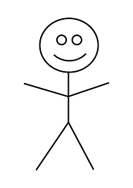
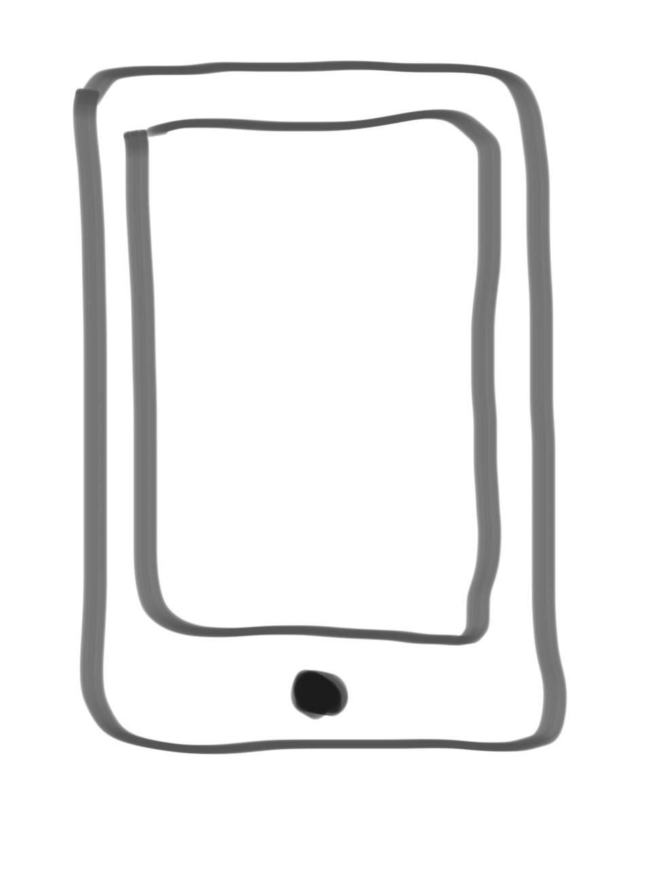
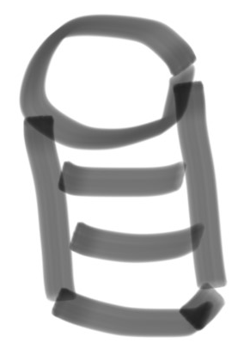
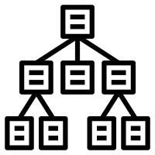


What Does Good Mean?
Training Environment
Performance Environment
Build Model
Dataset
Training
Data
Deploy
Customer
Interaction
Testing
Data
Evaluate Model
Estimated
Accuracy
Actual
Accuracy
$${accuracy}_{S}(h)$$
How do they
relate?
$${accuracy}_{D}(h)$$
77 out of 100 correct
?? out of 100,000 correct

Slide 4
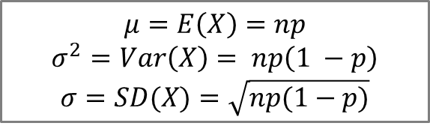
A Little Bit of Statistics
After trial 1: Most likely Accuracy is 70%
After trial 2: Most likely Accuracy is 60%
After trial 3: Most likely Accuracy is 60%
After trial 4: Most likely Accuracy is 55%
After trial 5: Most likely Accuracy is 54%
After trial 6: Most likely Accuracy is 50%
After trial 7: Most likely Accuracy is 48.6%
After trial 8: Most likely Accuracy is 50%
After trial n: Most likely Accuracy is 50%
Flip a coin 10 time, see 7 heads…
Test a model on 10 samples, see 7 correct...
$$μ=E\left(X\right)=np$$
$$σ^{2}=Var\left(X\right)= np\left(1 −p\right)$$
$$σ=SD(X)=\sqrt{np(1−p)}$$
Binomial Distribution
0%
10%
20%
30%
40%
50%
60%
70%
80%
90%
100%
= Accuracy in a single accuracy test on 10 samples
Notes:
Sigma^2 is variance

Slide 5

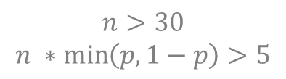
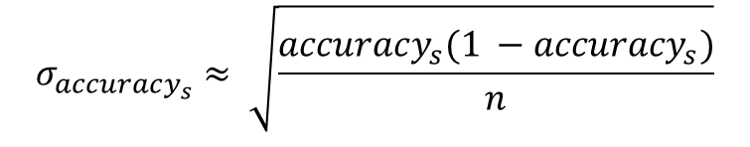
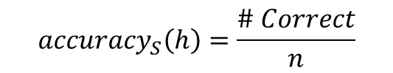
Central Limit Theorem
$$n>30$$
$$n ∗\min\left(p, 1−p\right)>5$$
Central Limit Theorem: distribution of sample means approximates
a normal distribution as the sample size gets large…
where the average of sample means is the population mean…
and the variance of the sample means is proportional to population variance…
$${accuracy}_{S}\left(h\right)=\frac{\# Correct}{n}$$
$$σ_{accuracy_{s}}≈ \sqrt{\frac{accuracy_{s}(1 −accuracy_{s})}{n}}$$
  Most Likely ${accuracy}_{D}\left(h\right)=accuracy_{s}(h)$
0%
10%
20%
30%
40%
50%
60%
70%
80%
90%
100%
= Accuracy in a single accuracy test on 10 samples

Slide 6

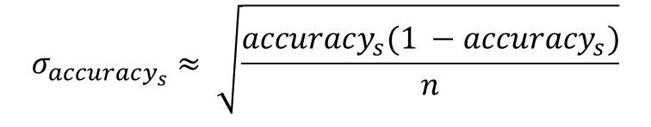
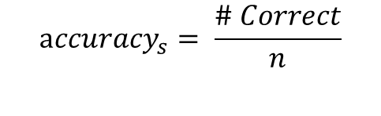

Intuition About Estimates of Generalization Accuracy
${accuracy}_{D}\left(h\right)=50\%$
$$accuracy_{s}= \frac{\# Correct}{n}$$
$$σ_{accuracy_{s}}≈ \sqrt{\frac{accuracy_{s}(1 −accuracy_{s})}{n}}$$
Higher / Lower accuracy means less variance & narrower distribution
${accuracy}_{D}\left(h\right)=90\%$
Notes:
Sigma -> Standard Deviation
Sigma^2 -> Variance

Slide 7
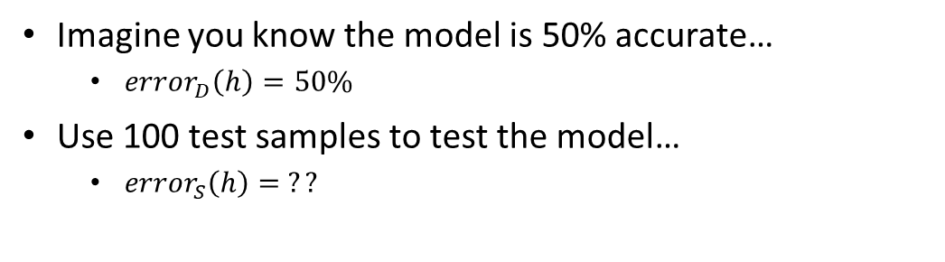
Looking at this from the other direction…
Imagine you know the model is 50% accurate…
  ${error}_{D}\left(h\right)=50\%$
Use 100 test samples to test the model…
  ${error}_{S}\left(h\right)= ??$
92% chance you’re going to see something other than 50 correct!
Probability of seeing 50 correct is about 8%
Probability of seeing 40 correct is about 1%
Probability of seeing 55 correct is about 4.8%
Probability of seeing 1 correct is very low
0
10
20
30
40
50
60
70
80
90
100
Number Correct on test set of 100 if Accuracy = 50%

Slide 8
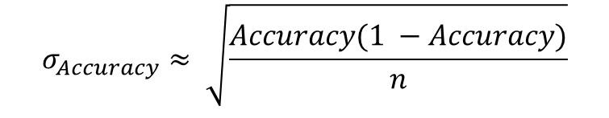
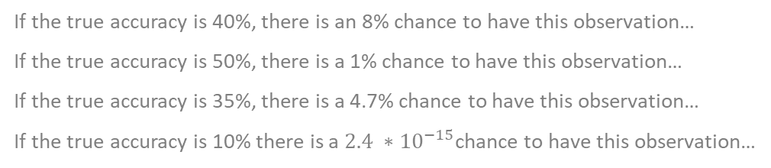
So How Accurate is my Model?
We know how things work when we know the model’s true accuracy…
What happens when we don’t know it?
Test the model on 100 samples, observe 40 correct…
What is the true accuracy of the model that generated this observation?
If the true accuracy is 40%, there is an 8% chance to have this observation…
If the true accuracy is 50%, there is a 1% chance to have this observation…
If the true accuracy is 35%, there is a 4.7% chance to have this observation…
If the true accuracy is 10% there is a $2.4 ∗{10}^{−15}$chance to have this observation…
$$σ_{Accuracy}≈ \sqrt{\frac{Accuracy(1 −Accuracy)}{n}}$$
Stdev of these distributions shrink as n grows
but we basically can never be sure of true accuracy
0%
10%
20%
30%
40%
50%
60%
70%
80%
90%
100%
= Accuracy in a single test on 100 samples

Slide 9

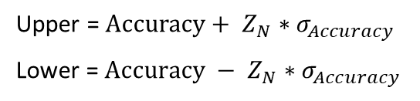
Confidence Bounds
We can’t know true accuracy of the model, but we can bound the true accuracy
  Probability a model with true accuracy of 40% generated the observation ~8%
  Probability some model with true accuracy between 35% and 45% generated the observation ~75%
  Probability some model with true accuracy between 27.5% and 52.5% generated the observation is ~99%
Add up the probability of all possibilities in this region
Upper = $Accuracy+ Z_{N}∗σ_{Accuracy}$
Lower = $Accuracy − Z_{N}∗σ_{Accuracy}$
Confidence | 95% | 98% | 99%
$$Z_{N}$$ | 1.96 | 2.33 | 2.58
0%
10%
20%
30%
40%
50%
60%
70%
80%
90%
100%
= Accuracy in a single test on 100 samples

Slide 10
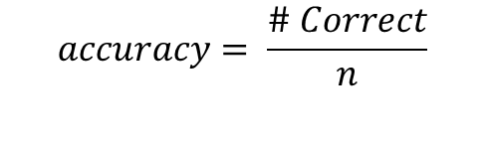
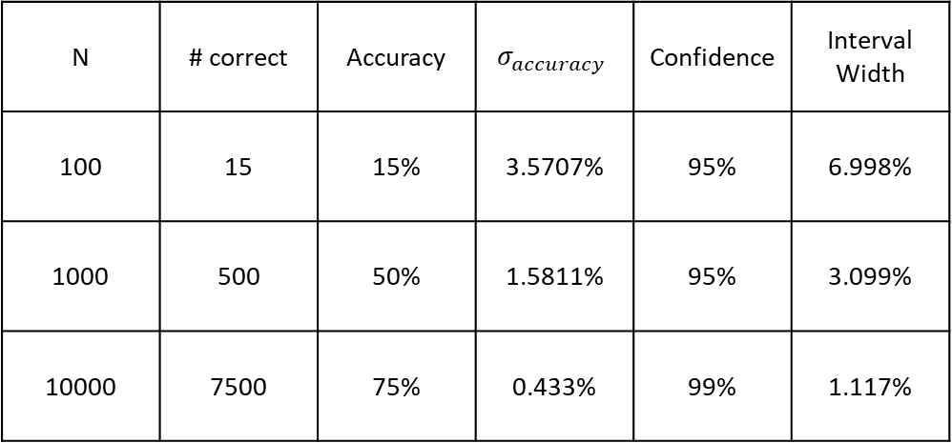
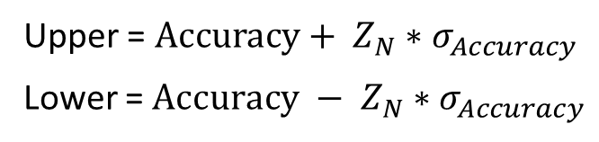
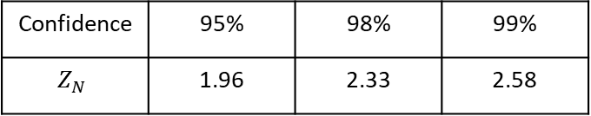
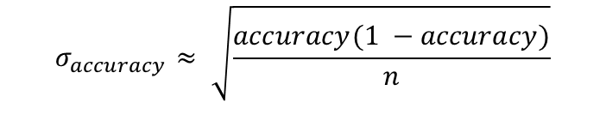
Confidence Interval Examples
$$accuracy= \frac{\# Correct}{n}$$
N | # correct | Accuracy | $$σ_{accuracy}$$ | Confidence | Interval Width
100 | 15 | 15% | 3.5707% | 95% | 6.998%
1000 | 500 | 50% | 1.5811% | 95% | 3.099%
10000 | 7500 | 75% | 0.433% | 99% | 1.117%
$$σ_{accuracy}≈ \sqrt{\frac{accuracy(1 −accuracy)}{n}}$$
Upper = $Accuracy+ Z_{N}∗σ_{Accuracy}$
Lower = $Accuracy − Z_{N}∗σ_{Accuracy}$
Confidence | 95% | 98% | 99%
$$Z_{N}$$ | 1.96 | 2.33 | 2.58
0%
10%
20%
30%
40%
50%
60%
70%
80%
90%
100%

Slide 11
Summary of Error Bounds
Can’t know model’s true accuracy when evaluating on a sample (which you always are)
Central Limit Theorem gives the relationship between true accuracy and accuracy observed on a sample
Can calculate the probability of a model with X percent true accuracy generating a sample accuracy of Y
Error bounds give high confidence intervals for the true accuracy for any observed sample accuracy
Generalization accuracy is not a number → it is a distribution!

Slide 12
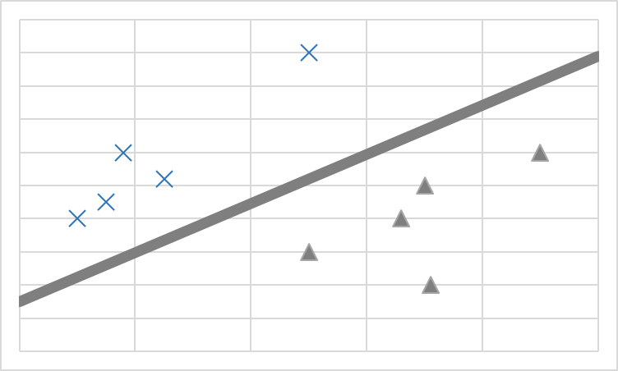




Comparing Models
Training Environment
Performance Environment
Build a New Model
Dataset
Training
Data
Deploy??
Customer
Interaction
Testing
Data
Evaluate Models
Actual
Accuracy
Estimated
Accuracies
$${accuracy}_{S}(tree)$$
$${accuracy}_{D}(tree)$$
Which will be
better?
$${accuracy}_{S}(linear)$$
$${accuracy}_{D}(linear)$$

Slide 13
Comparing Models using Confidence Intervals
IF: Better_Model – Bound > Worse_Model + Bound
THEN: With XX% confidence the model that looks better on the sample is better
ELSE: there is more than a (1 - XX%) chance the model that looks worse is actually better
Bounds Overlap
Samples | Better_Model: 89% – Bound | Worse_Model: 80% + Bound
100 | 82.9% | 87.8%
200 | 84.7% | 85.5%
1000 | 87.0% | 82.5%
0%
10%
20%
30%
40%
50%
60%
70%
80%
90%
100%
0%
10%
20%
30%
40%
50%
60%
70%
80%
90%
100%
0%
10%
20%
30%
40%
50%
60%
70%
80%
90%
100%
95% Confidence Interval

Slide 14
One Sided Bounds
Bounds don’t overlap so the
better model is better with 95% confidence
95% chance the accuracy of the model that produced this observation is in this range
2.5% chance the accuracy of the model that produced this observation is below the range
2.5% chance the accuracy of the model that produced this observation is above the range
If by chance the worse model is even more worse than we thought… It doesn’t matter, the better model is still better
If by chance the better model is even more better than we thought… It doesn’t matter, the better model is still better
0%
10%
20%
30%
40%
50%
60%
70%
80%
90%
100%
95% Confidence Interval
97.5% One Sided Confidence Bound

Slide 15
Using Bounds to Make Decisions
Should you deploy a new model?
# Test the existing production model
currentAccuracyUpperBound =
evaluateWithUpperBound(testY, currentModel.predict(testX), confidenceTarget)
# Find the best model using your new modeling approach
for p in hyperParametersToTry:
model.fit(trainX, trainY, p)
accuracies[p] = evaluate(validationY, model.predict(validationX))
bestPFound = bestHyperParametersFound(accuracies)
newModel.fit(trainX+validationX, trainY+validationY, bestPFound)
newAccuracyLowerBound =
evaluateWithLowerBound(testY, newModel.predict(testX), confidenceTarget)
if newAccuracyLowerBound > currentAccuracyUpperBound:
# Deploy the newModel (with confidenceTarget / 2.0)
else:
# Stick with currentModel
For regular retraining might deploy unless:
newAccuracyUpperBound < currentAccuracyLowerBound

Slide 16
Machine Learning Does LOTS of Tests
For each type of feature selection, for each hyper parameter setting, for each model structure you try…
# Tests | P(all hold)
1 | .95
10 | .598
100 | .00592
1000 | 5.29E-23
# Tests | P(all hold)
1 | .999
10 | .990
100 | .9048
1000 | .3677
95% Bounds
99.9% Bounds

Slide 17
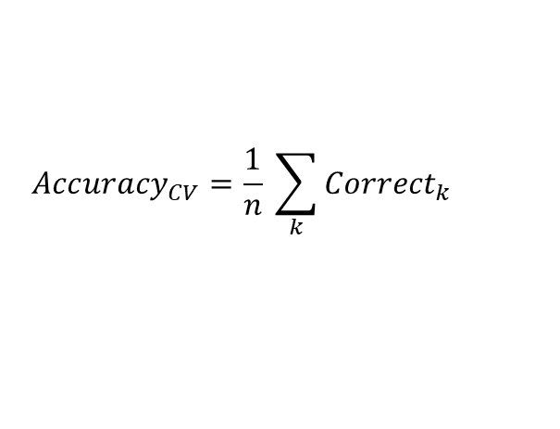

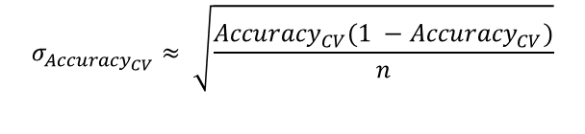
Evaluating Modeling Process with Cross Validation
Is some new parameter/feature worth the time/effort?
$$σ_{Accuracy}≈ \sqrt{\frac{Accuracy(1 −Accuracy)}{n}}$$
Train with and without feature
Compare using one sided bounds
Training Data
Validation Data
Bounds overlap?
Get more Data?
Stop Optimizing?
Test Data
Split data into k ‘folds’
Train with & without feature
on k-1; validate on 1
Use all validation data when calculating bounds
Probably want to reserve test data, depending on needs
Train
Train
Train
Validate
Validate
$${Accuracy}_{CV}=\frac{1}{n} \sum_{k}{{Correct}_{k}}$$
Train
Train
Validate
Train
Validate
Repeat n times
$$σ_{{Accuracy}_{CV}}≈ \sqrt{\frac{{Accuracy}_{CV}(1 −{Accuracy}_{CV})}{n}}$$
Validate
Train
Validate
Train
Train
Validate
Validate
Train
Train
Train

Slide 18
Cross Validation pseudo-code
totalCorrect = 0
for i in range(K):
(foldTrainX, foldTrainY) = GetAllDataExceptFold(trainX, trainY, i)
(foldValidationX, foldValidationY) = GetDataInFold(trainX, trainY, i)
# do feature engineering/selection on foldTrainX, foldTrainY
model.fit(foldTrainX, foldTrainY)
# featurize foldValidationX using the same method you used on foldTrainX
totalCorrect += CountCorrect(model.predict(foldValidationX), foldValidationY)
accuracy = totalCorrect / len(trainX)
upper = accuracy + z * sqrt( (accuracy * (1 - accuracy) ) / len(trainX) )
lower = accuracy - z * sqrt( (accuracy * (1 - accuracy) ) / len(trainX) )

Slide 19
When to use cross validation
When you need to measure variance of modeling process
  Feature selection on different data creates variance
  Building model on different data creates variance
  Some ML algorithms include randomization which causes variance
And be careful of:
  Time series
  Dependencies (e.g. spam campaigns)
  Other violations of independence assumptions

Slide 20
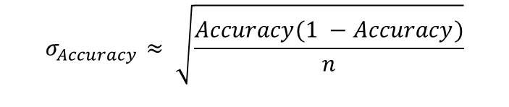
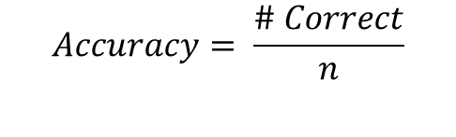
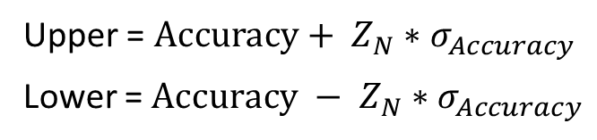
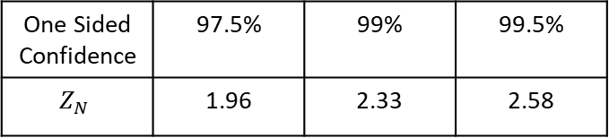
Summary
$$σ_{Accuracy}≈ \sqrt{\frac{Accuracy(1 −Accuracy)}{n}}$$
$$Accuracy= \frac{\# Correct}{n}$$
Use statistics to know relationship between model quality on training data and model quality on the true concept.
One sided bounds can give probability one model is better than another on true concept
Cross Validation standard technique to get more statistical power out of your training data & measure modeling process
When modeling: don’t think in terms of point accuracies; think in terms of distributions of possible accuracies
One Sided Confidence | 97.5% | 99% | 99.5%
$$Z_{N}$$ | 1.96 | 2.33 | 2.58
Upper = $Accuracy+ Z_{N}∗σ_{Accuracy}$
Lower = $Accuracy − Z_{N}∗σ_{Accuracy}$

