Slide 1
Overfitting and Underfitting
Geoff Hulten

Slide 2




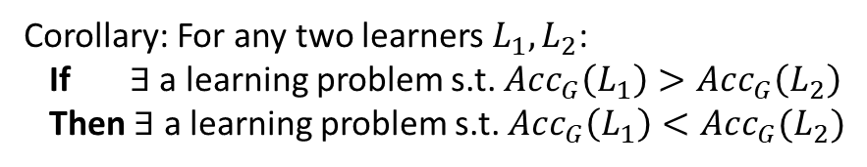


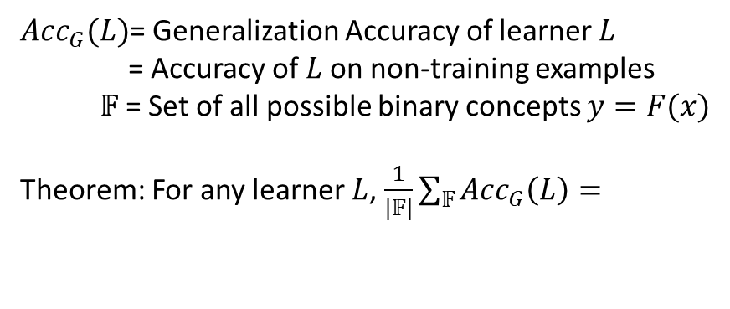




No Free Lunch Theorem
$Acc(A)$: 100%
$Acc(B)$: 50%
$Acc_{G}(L)$= Generalization Accuracy of learner $L$
= Accuracy of $L$on non-training examples
$𝔽$ = Set of all possible binary concepts $y=F(x)$
Theorem: For any learner $L$, $\frac{1}{|𝔽|}\sum_{𝔽}{Acc_{G}\left(L\right)= }$
$𝔽$ – set of all possible concepts
Learner: A
$$\frac{1}{2}$$
Learner: B
Training Data
Generalization Data
When all concepts equally likely
$$X$$
1
2
3
4
…
$$A(X)$$
1
1
0
0
…
$$B(X)$$
0
1
0
1
…
$$Ϝ(X)$$
1
1
0
0
…
$$Ϝ^{′}(X)$$
0
1
0
1
…
Corollary: For any two learners $L_{1}, L_{2}$:
If $∃$ a learning problem s.t. $Acc_{G}\left(L_{1}\right)>Acc_{G}\left(L_{2}\right)$
Then $∃$ a learning problem s.t. $Acc_{G}\left(L_{1}\right)<Acc_{G}(L_{2})$
$Acc_{G}(A)$: 100%
$Acc_{G}(B)$: 50%
$Acc_{G}(A)$: 50%
$Acc_{G}(B)$: 100%
Don’t expect your favorite learner to always be best!

Slide 3

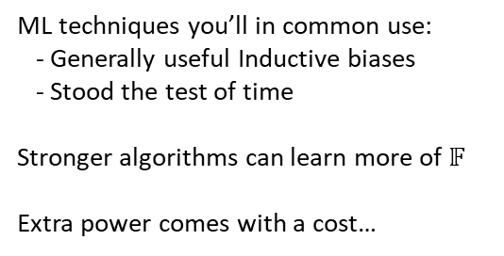
Inductive Bias
Assumptions you make about how likely any particular concept is
$𝔽$ – set of all possible concepts
Common Assumptions:
Model Structure:
Linear model
Axis-aligned tree structure
Labels are clustered
Model Selection:
Train / Test / Validate
Cross Validation
Concept Complexity:
Occam’s Razor
Regularization
Choose Learning Algorithm
Assume I.I.D
Control Optimization
ML techniques you’ll in common use:
- Generally useful Inductive biases
- Stood the test of time
Stronger algorithms can learn more of $𝔽$
Extra power comes with a cost…
Concepts you might learn
using a particular inductive bias
$$𝔽$$

Slide 4
Statistical Bias and Variance
Bias – error caused because the model can not represent the concept
Variance – error caused because the learning algorithm overreacts to small changes in the training data
TotalLoss = Bias + Variance (+ noise)

Slide 5
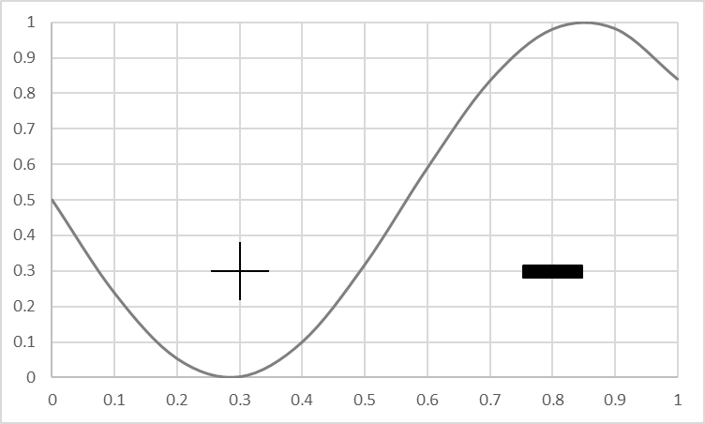
Visualizing Bias
Goal: produce a model that matches this concept
True Concept

Slide 6
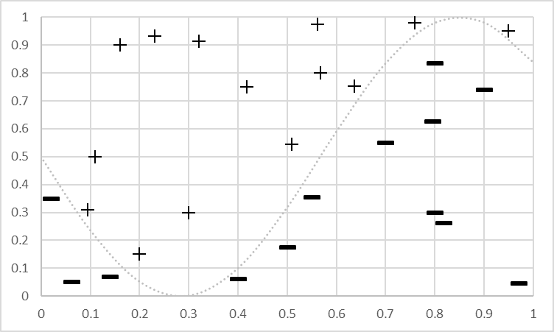
Visualizing Bias
Goal: produce a model that matches this concept
Training Data for the concept
Training Data

Slide 7
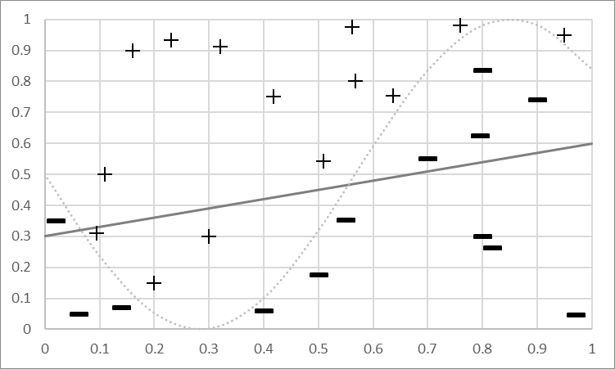
Visualizing Bias
Bias Mistakes
Goal: produce a model that matches this concept
Training Data for concept
Bias: Can’t represent it…
Model Predicts +
Model Predicts -
Fit a Linear Model

Slide 8
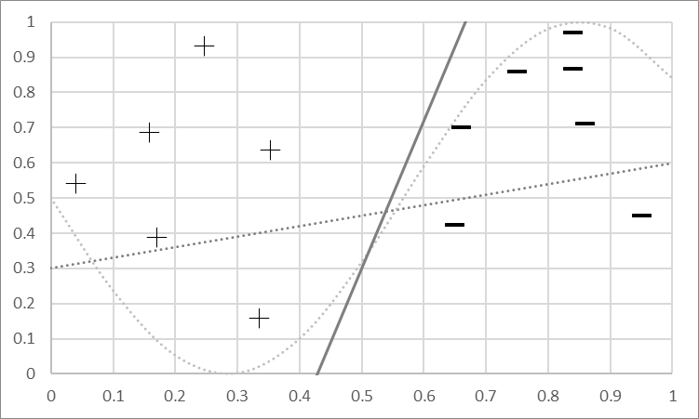
Visualizing Variance
Different Bias Mistakes
Goal: produce a model that matches this concept
New data, new model
Model Predicts +
Model Predicts -
Fit a Linear Model

Slide 9
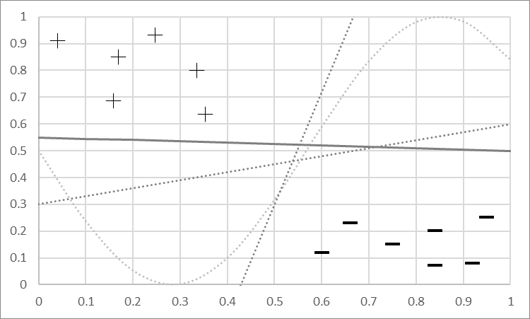
Visualizing Variance
Mistakes will vary
Goal: produce a model that matches this concept
New data, new model
New data, new model…
Variance: Sensitivity to changes & noise
Model Predicts +
Model Predicts -
Fit a Linear Model

Slide 10
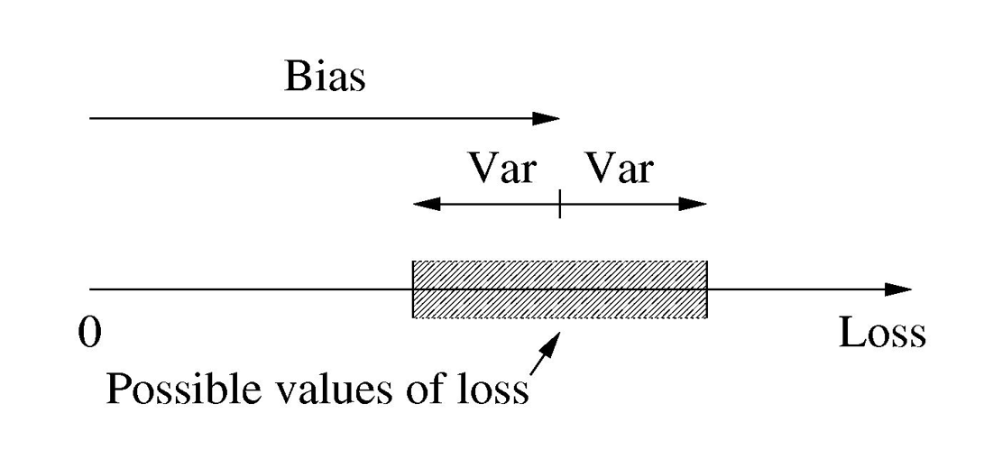
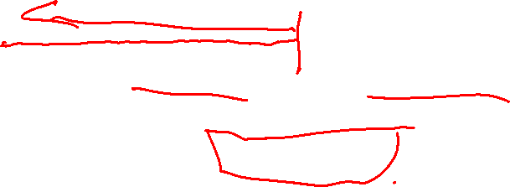
Another way to think about Bias & Variance

Slide 11
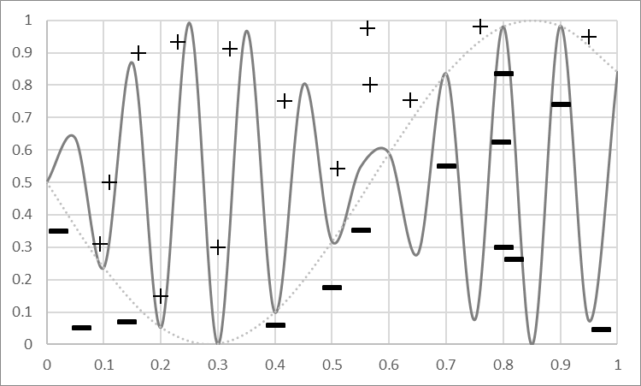
Bias and Variance: More Powerful Model
Model
Predicts +
Powerful Models can represent complex concepts
No Mistakes!
Model Predicts -

Slide 12
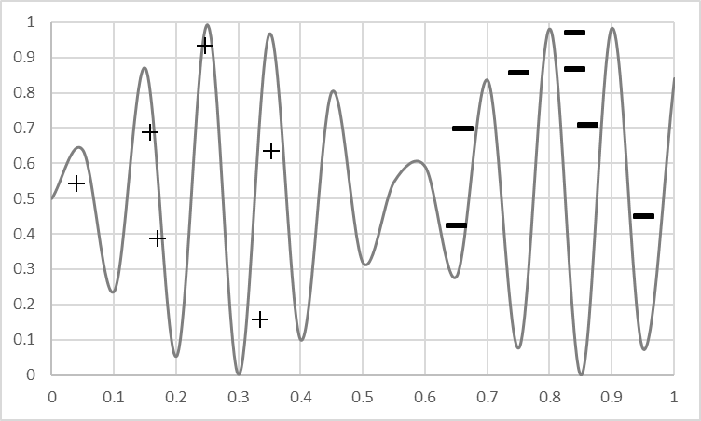
Bias and Variance: More Powerful Model
Model
Predicts +
But get more data…
Not good!
Model Predicts -

Slide 13
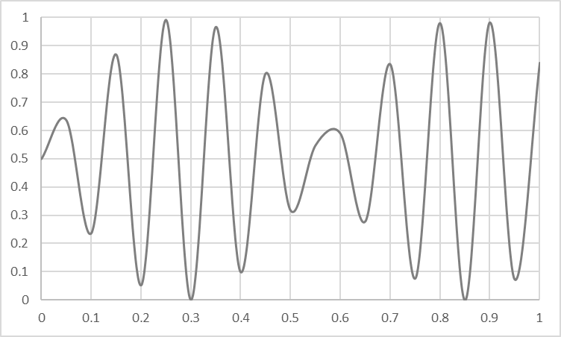
Overfitting vs Underfitting
Overfitting
Underfitting
Fitting the data too well
  Features are noisy / uncorrelated to concept
  Modeling process very sensitive (powerful)
  Too much search
Learning too little of the true concept
  Features don’t capture concept
  Too much bias in model
  Too little search to fit model

Slide 14
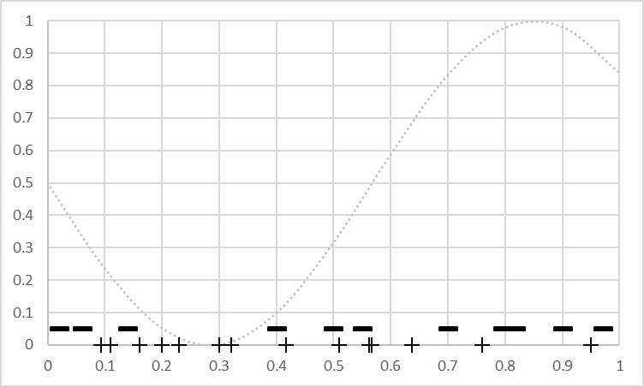
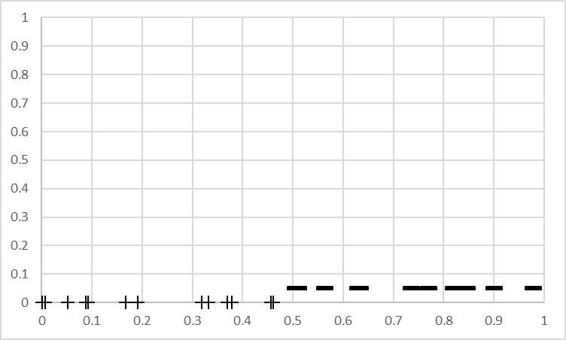


The Effect of Features
Not much info
Won’t learn well
Powerful -> high variance
Throw out $x_{2}$
Captures concept
Simple model -> low bias
Powerful -> low variance
N$ew x_{3}$

Slide 15
The Effect of Noise
Low bias learner can fit noise, can overfit
High bias learner can’t fit noise, less affected

Slide 16
The Power of a Model Building Process
Weaker Modeling Process
( higher bias )
More Powerful Modeling Process
(higher variance)
Simple Model (e.g. linear)
Fixed sized Model (e.g. fixed # weights)
Small Feature Set (e.g. top 10 tokens)
Constrained Search (e.g. few iterations of gradient descent)
Complex Model (e.g. high order polynomial)
Scalable Model (e.g. decision tree)
Large Feature Set (e.g. every token in data)
Unconstrained Search (e.g. exhaustive search)

Slide 17
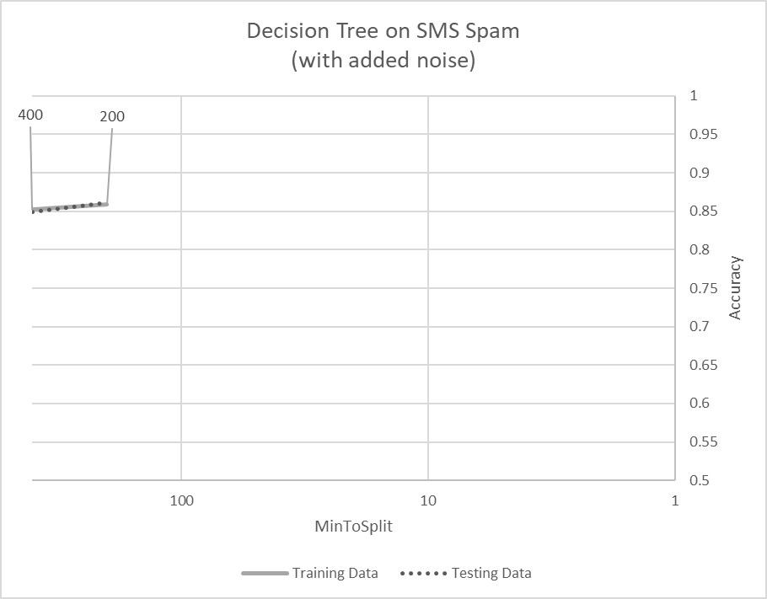
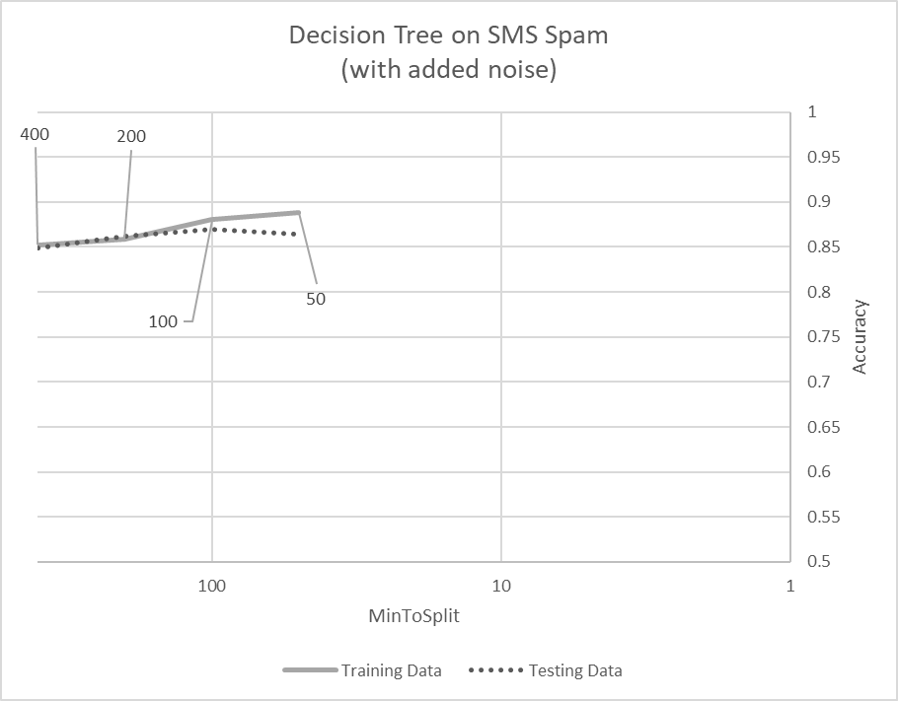
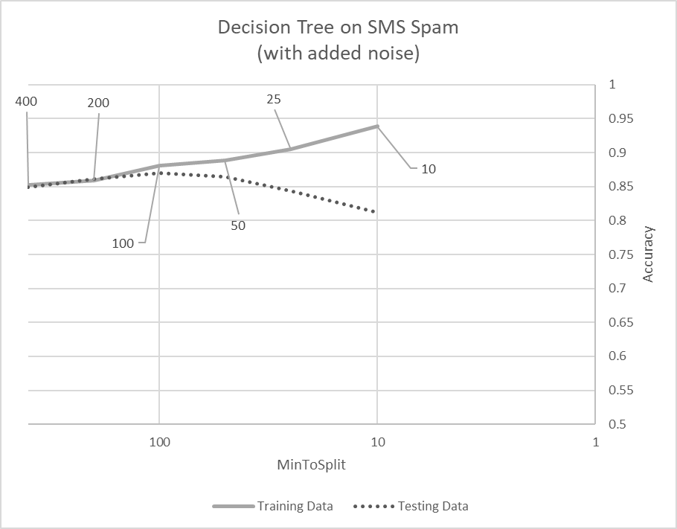
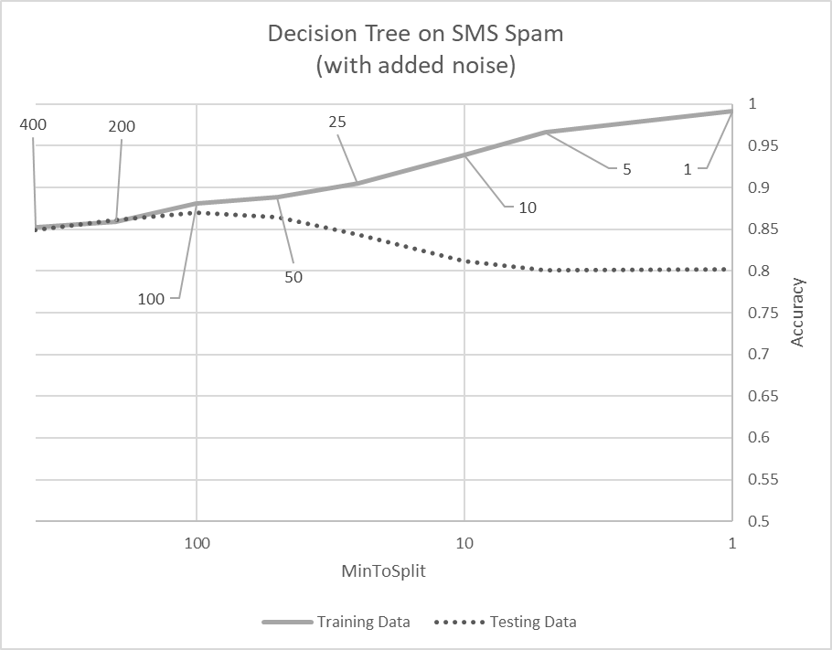
Example of Under/Over-fitting

Slide 18

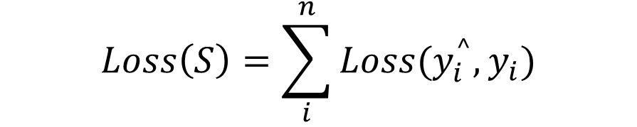
Ways to Control Decision Tree Learning
Increase minToSplit
Increase minGainToSplit
Limit total number of Nodes
Penalize complexity
$$Loss\left(S\right)=\sum_{i}^{n}{Loss(y_{i}^{^},y_{i})}$$
$$+ α {Log}_{2}(\# Nodes)$$

Slide 19
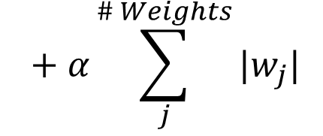
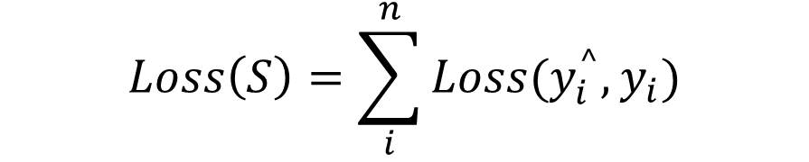
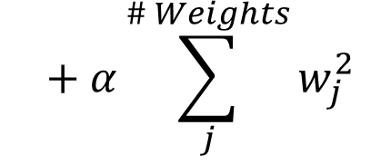
Ways to Control Logistic Regression
Adjust Step Size
Adjust number of iterations / stopping criteria of Gradient Descent
Regularization
L-1 regularization
Built-in feature selection
$$Loss\left(S\right)=\sum_{i}^{n}{Loss(y_{i}^{^},y_{i})}$$
$$+ α\sum_{j}^{\# Weights}{|w_{j}|}$$
L-2 regularization
Analytical solution
$$+ α\sum_{j}^{\# Weights}{w_{j}^{2}}$$

Slide 20
Modeling to Balance Under & Overfitting
Data
  Amount
    more data -> less overfitting
  Cleanliness
    more noise -> more overfitting
    Label noise and context bugs
Learning Algorithms
  Aligned with concept
    better representation -> less overfitting
  Representative power
    more power -> less bias; more variance
  Responsiveness to noise
    sensitive model -> more overfitting
Feature Sets
  Feature engineering / selection
    More features -> generally less underfitting
    Too many features -> overfitting
    Noisy features -> lots of overfitting
Search and Computation
  Less search -> less overfitting, more underfitting
  Constrained search -> less overfitting, more underfitting
Parameter sweeps
  Examine results, plot them
  Ask why, investigate
  Respond accordingly

Slide 21
Summary of Overfitting and Underfitting
Bias / Variance tradeoff a primary challenge in machine learning
Internalize: More powerful modeling is not always better
Learn to identify overfitting and underfitting
Tuning parameters & interpreting output correctly is key

