Slide 1
Ensembles
Part 3 – Stacking and Intelligence Architectures
Geoff Hulten

Slide 2




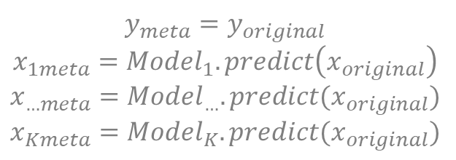
Stacking
Potentially Different Model Types
$$y_{meta}=y_{original}$$
$$x_{1meta}={Model}_{1}.predict\left(x_{original}\right)$$
$$x_{…meta}={Model}_{…}.predict(x_{original})$$
$$x_{Kmeta}={Model}_{K}.predict(x_{original})$$
Parallel Training
Possible
Decision Tree
Prediction time: run base models then run meta model
Linear Model
Training
Set
…
Meta Training
Set
Apply multiple base learners
(e.g.: decision trees, logistic regression, neural nets, etc)
Meta-learner:
Features = base learner predictions
Labels = labels from original training set
Train meta-learner on holdout data, e.g.:
Leave-out-one cross-validation
Hold out one sample
Train all base learners on remaining data
Meta sample produced on hold-out sample
Repeat for all training samples
Important!
Neural Network
Base Training
Meta Data
Meta Training

Slide 3
Stacking Pseudocode
learners = [ DecisionTree(), LogisticRegression(), NeuralNetwork(), KNN(), <etc…> ]
metaTrainX = []
for # iterate over samples, s
baseModels = [ learner.fit(trainX - s, trainY - s, <params>) for learner in learners ]
metaTrainX.append( [ model.predict( [ s ] ) for model in baseModels ]
metamodel = DecisionTree() # or whatever
metamodel.fit(metaTrainX, trainY, <params>)
metaTestX = []
for testSample in testX:
metaTestX.append( [ model.predict( [ testSample ] ) for model in baseModels ]
yPredictions = [ metamodel.predict(x) for x in metaTestX ]

Slide 4

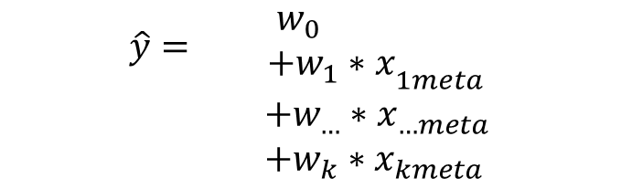

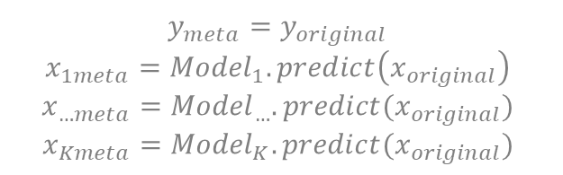





More on Stacking
$$y_{meta}=y_{original}$$
$$x_{1meta}={Model}_{1}.predict\left(x_{original}\right)$$
$$x_{…meta}={Model}_{…}.predict(x_{original})$$
$$x_{Kmeta}={Model}_{K}.predict(x_{original})$$
$$\hat{y}={\begin{aligned}w_{0} \\ +w_{1}∗x\end{aligned}}_{1meta}$$
$$+w_{…}∗x_{…meta}$$
$+w_{k}∗x_{kmeta}$
Base models learn the concept different ways (variance)
  Control the amount of variance by choosing which/how many base models
Meta model learns how to value the votes of different base models
  A simple meta-model (logistic regression) weights base model votes
  A complex meta-model (random forest) can learn relationships between voting blocks
  (or it can overfit)
$$x_{1meta}=1?$$
False
True
$$x_{2meta}=1?$$
$$\hat{y}=1$$
False
True
$$\hat{y}=0$$
$$x_{3meta}=1?$$
False
True
$$\hat{y}=0$$
$$\hat{y}=1$$

Slide 5







Stacking Features
Trust different base models more in different situations
Decision Tree
$$DarkImage=1?$$
False
True
$$x_{2meta}=1?$$
$$x_{3meta}=1?$$
Linear Model
…
False
True
False
True
Training
Set
Meta Training
Set
$$\hat{y}=0$$
$$\hat{y}=1$$
$$\hat{y}=0$$
$$\hat{y}=1$$
Neural Network
Challenges with Stacking:
Tightly Coupled – powerful but brittle
Hard to know where to optimize
Hard to track mistakes
Base Features
(or subset)

Slide 6
Properties of Well Organized Intelligence
Accurate
Easy to Grow
Loosely Coupled
Comprehensible (mistakes)
Measurable (value of)
Supportive of Team

Slide 7
Stacking and Intelligence Organization
As a team accelerator (Kaggle Pattern)
Everyone develops features/models
Each base model hand-tuned for bias/variance
Learned Meta Model
As an algorithm (Stacking)
Single feature set
Learned Meta Model
Meta Complexity
As a method for combining with business logic
Partitioned feature types
Hand crafted (or very simple) meta model
As an Intelligence Architecture
Everyone develops features/models
Each base model hand-tuned for bias/variance
Hand crafted (or very simple) meta model
Feature Complexity

Slide 8

Intelligence Architecture for Team Accelerator
Better
Filter
Filter
Email Store
Junk Store
P(Spam | Content)
P(Spam | Content, Reputation)
P(Spam | Reputation)
P(Spam | Images)
Meta Learner
Email Store
Junk Store
P(Spam | Links)
P(Spam | Content)
Better
Filter
P(News Letter | Content)
++
-
--
--
-
OK
Accurate
Easy to Grow
Loosely Coupled
Comprehensible
Measurable
Supportive of Team
Email Store
Junk Store
P(Spam | Content, Reputation, Images, Links, News Letter, etc.)

Slide 9
Intelligence Architecture for Business Logic
P(Spam | Content)
Reputation
Filter
P(Spam | Reputation)
Other Logic:
If it might be a newsletter don’t delete
If it links to a malware site delete no matter what
If the message seems important notify user
etc…
Known Good?
P(Spam | Images)
Content
Filter
P(Spam | Links)
P(News Letter | Content)
Email Store
Junk Store
OK
?
?
?
?
OK
Accurate
Easy to Grow
Loosely Coupled
Comprehensible
Measurable
Supportive of Team
May get complex, lead to problems…

Slide 10
Intelligence Architecture: Model Sequencing
Tuned for fixed FP Target
Model 1
Model 2
Model 3
Model …
Override?
Override?
Override?
Override?
Default answer 0
OK
+
++
++
OK
+
Accurate
Easy to Grow
Loosely Coupled
Comprehensible
Measurable
Supportive of Team
Orchestrator hand-orders models
Each FP can be traced back to the model that caused it
Each FN is everyone’s mistake

Slide 11
Intelligence Architecture: Partitioning Contexts
Large Web Site?
No
Yes
In EU?
Modeler 1
Modeler 2
No
Yes
Modeler 2
Modeler 3
OK
++
+
+
+
+
Accurate
Easy to Grow
Loosely Coupled
Comprehensible
Measurable
Supportive of Team
Orchestrator carves problem into pieces
Each leaf is solved by a model, heuristics or another architecture
Solve the easy problem the easy way, focus in on hard places

Slide 12
Summary
Stacking learns a set of base models, then uses a meta-learner that takes base model predictions as input
Train meta-model on holdout data!
  E.g. Leave out one cross validation
Select base models & meta-model based on bias/variance properties
Organizing Intelligence is critical for long term success with ML
  Stacking (meta models)
  Business Logic
  Sequencing
  Partitioning
Restricting flexibility in the short term can lead to long term benefit
Without careful planning you’ll end up with spaghetti intelligence

