Slide 1
Neural Networks
Geoff Hulten

Slide 2
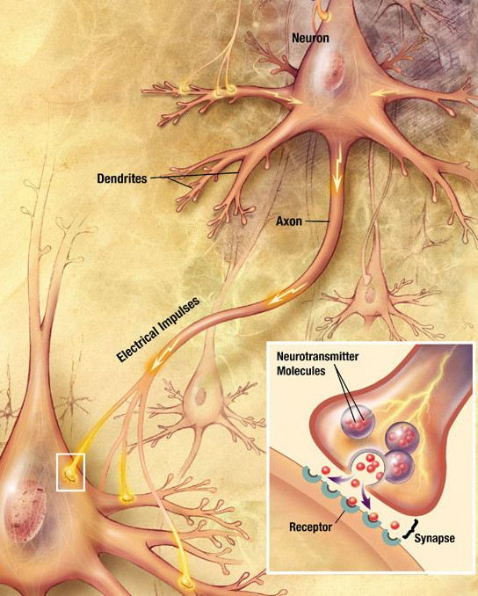
The Human Brain
(According to a computer scientist)
Send electro-chemical signals
Network of ~100 Billion Neurons
Each ~1,000 – 10,000 connections
Activation time ~10 ms second
~100 Neuron chain in 1 second
Image from Wikipedia

Slide 3
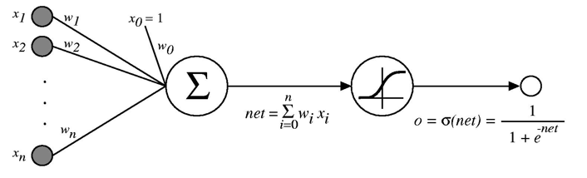
Artificial Neural Network
Grossly simplified approximation of how the brain works
Features used as input to an initial set of artificial neurons
Output of artificial neurons used as input to others
Output of the network used as prediction
Mid 2010s image processing
  ~50-100 layers
  ~10-60 million artificial neurons
Artificial Neuron (Sigmoid Unit)
50 million into 100 billion → 0.05%

Slide 4






Example Neural Network
Fully connected network
Single Hidden Layer
2313 weights to learn
4 neurons in hidden layer
$$x_{0}$$
1 connection per pixel
+ bias
$$x_{0}$$
$$x_{0}$$
1 connection per pixel
+ bias
$$x_{0}$$
$$P(y=1)$$
1 connection per pixel
+ bias
576 Pixels
(Normalized)
$$x_{0}$$
1 connection per pixel
+ bias
2,308 Weights
5 Weights
Input Layer
Hidden Layer
(of artificial neurons)
Output Layer

Slide 5






Decision Boundary for Neural Networks
Neural network with single node in output layer
(no hidden layer)
20 Hidden Nodes
Concept
Linear Model
10 Hidden Nodes
Non-linear decision boundary
- Enabled by non-linear (sigmoid) activation
- Complexity via network structure
6 Hidden Nodes
Underfitting
4 Hidden Nodes
1 Layer
Neural Network

Slide 6
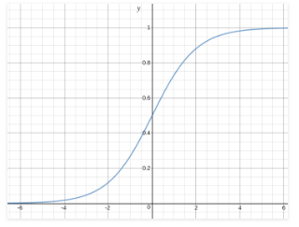

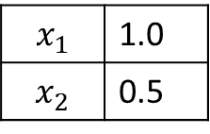
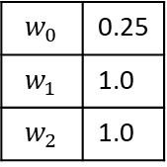
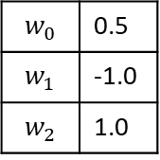
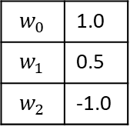
Example of Predicting with Neural Network
Sigmoid Function
Hidden Layer
$$w_{0}$$ | 0.5
$$w_{1}$$ | -1.0
$$w_{2}$$ | 1.0
0.0
~0.5
$$x_{1}$$ | 1.0
$$x_{2}$$ | 0.5
1.5
$$P\left(y=1\right)=\sim 0.82$$
~0.75
1.0
$$w_{0}$$ | 0.25
$$w_{1}$$ | 1.0
$$w_{2}$$ | 1.0
$$w_{0}$$ | 1.0
$$w_{1}$$ | 0.5
$$w_{2}$$ | -1.0
Output Layer
Activations
Input Layer

Slide 7

Example for Blink Task
You do limited feature engineering
  Scale
  Normalize
Hidden nodes learn useful features so you don’t have to…
Difficulties include:
  How many neurons to use?
  How to organize them?
  How to converge a training run?
Positive Weight?
Weights from
Hidden Node 1
$$P(y=1)$$
Negative Weight?
Logistic Regression
with responses as input
Input Image
(Normalized)
Weights from
Hidden Node 2

Slide 8
Multi-Layer Neural Networks
Fully connected network
Two Hidden Layers
2333 weights to learn
Filters on filters, for example maybe:
  Layer 1 learns eye shapes
  Layer 2 learns combinations
1 connection per pixel
+ bias
1 connection per pixel
+ bias
$$P(y=1)$$
1 connection per pixel
+ bias
576 Pixels
(Normalized)
Output Layer
1 connection per pixel
+ bias
2,308 Weights
5 Weights
20 Weights
Hidden Layer
Hidden Layer

Slide 9




Decision Boundary for Multi-Layer Neural Networks
20 Hidden Nodes
20 Per Layer
Did not converge
10 Hidden Nodes
10 Per Layer
Concept
Linear Model
6 Hidden Nodes
6 Per Layer
Best Fit
Much more powerful
- Difficult to converge
- Easy to overfit
- Later lecture: how to adapt
4 Hidden Nodes
4 Per Layer
1 Hidden Layer
Neural Network
2 Hidden Layer
Neural Network

Slide 10




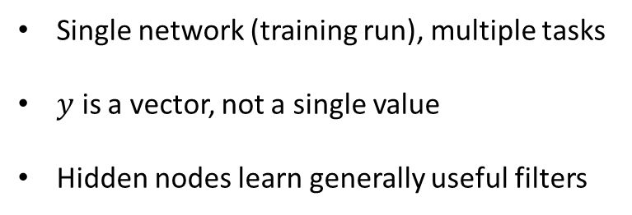
Output Layer
Single network (training run), multiple tasks
$y$ is a vector, not a single value
Hidden nodes learn generally useful filters
$$P(eyeOpened)$$
$$P(leftEye)$$
$$P(glasses)$$
576 Pixels
(Normalized)
$$P(child)$$
Hidden Layer
Output Layer

Slide 11
Neural Network Architectures/Concepts
Fully connected layers
Convolutional Layers
MaxPooling
Activation (ReLU)
Softmax
Recurrent Networks (LSTM & attention)
Embeddings
Residual Networks
Batch Normalization
Dropout
Will explore in more detail later

Slide 12
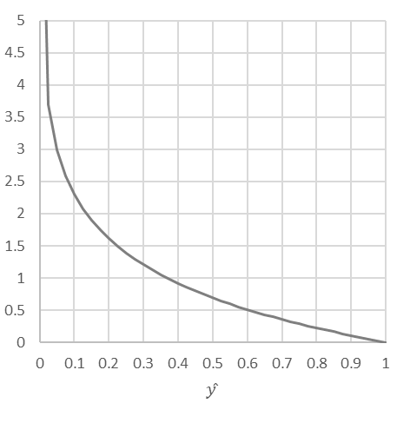
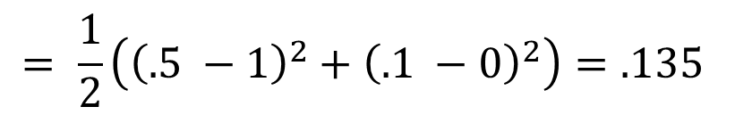
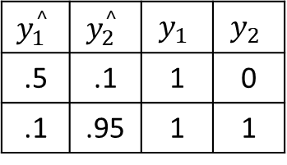

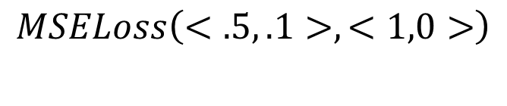
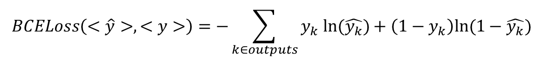
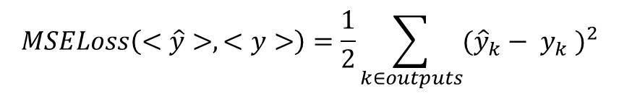

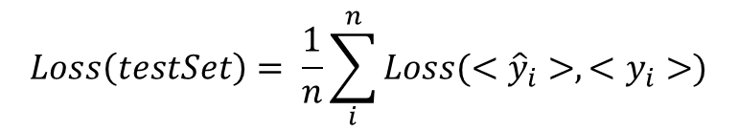

Loss For Neural Networks
In Book
Use for Assignment
$$MSELoss\left(<\hat{y}>, <y>\right)=\frac{1}{2}\sum_{k∈outputs}{{({\hat{y}}_{k}− y_{k} )}^{2}}$$
Mean Squared Error (MSE):
$$BCELoss\left(<\hat{y}>, <y>\right)=−\sum_{k∈outputs}{y_{k} ln⁡(\hat{y_{k}})+\left(1−y_{k}\right)ln⁡(1−\hat{y_{k}})}$$
Cross Entropy (BCE):
$$= \frac{1}{2}\left({\left(.5 −1\right)}^{2}+{\left(.1 −0\right)}^{2}\right)=.135$$
$$MSELoss\left(<.5, .1>, <1,0>\right)$$
$$−ln⁡(\hat{y})$$
$BCELoss\left(<.5, .1>, <1,0>\right) =−(\ln\left(.5\right)+\ln\left(1 − .1\right)) = .795$
For: $y_{1}$
For: $y_{2}$
$$y_{1}^{^}$$ | $$y_{2}^{^}$$ | $$y_{1}$$ | $$y_{2}$$
.5 | .1 | 1 | 0
.1 | .95 | 1 | 1
$$Loss\left(testSet\right)= \frac{1}{n}\sum_{i}^{n}{Loss(<{\hat{y}}_{i}>, <y_{i}>)}$$

Slide 13
Optimizing Neural Nets – Back Propagation
Gradient descent over entire network’s weight vector
Easy to adapt to different network architectures
Converges to local minimum (usually won’t find global minimum)
Training can be very slow!
  For this week’s assignment…sorry…
  For next week we’ll use public neural network software
  In general very well suited to run on GPU

Slide 14



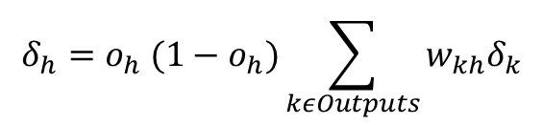
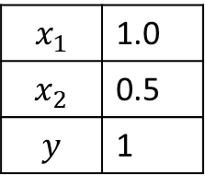




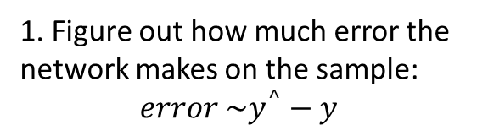
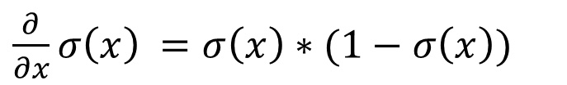
Conceptual Backprop with MSE
Forward Propagation
Back Propagation
Update Weights
$$Chain Rule:F^{′}=f^{′}\left(g\left(x\right)\right)∗g′(x)$$
$\frac{∂}{∂x}σ\left(x\right) =σ\left(x\right)∗(1−σ\left(x\right))$
$$δ_{h1}$$
With MSE: $δ_{o}=y^{^}(1−y^{^})(y−y^{^})$
~0.5
2. Figure out how much each part contributes to the error.
$$δ_{o}$$
~0.82
$$x_{1}$$ | 1.0
$$x_{2}$$ | 0.5
$$y$$ | 1
1. Figure out how much error the network makes on the sample:
$$error \sim y^{^}−y$$
~0.75
$$δ_{h2}$$
$$δ_{h}=o_{h} (1−o_{h})\sum_{kεOutputs}{w_{kh}δ_{k}}$$
${∆w}_{oi}=αδ_{o}{Input}_{i}$
3. Step each weight to reduce the error it is contributing to
${∆w}_{hj.i}=∝δ_{hj} {Input}_{i}$

Slide 15
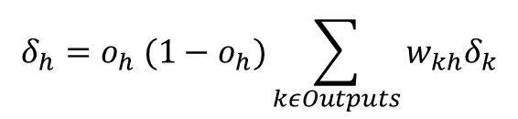
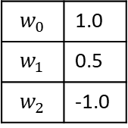
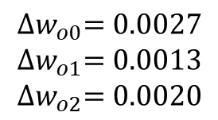

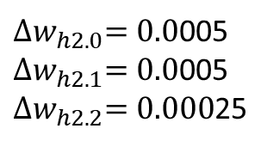

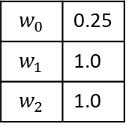


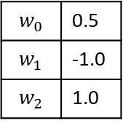


Backprop Example
Forward Propagation
Back Propagation
Update Weights
$$w_{0}$$ | 0.5
$$w_{1}$$ | -1.0
$$w_{2}$$ | 1.0
$$α=0.1$$
$$δ_{h1}$$
$$δ_{o}=y^{^}(1−y^{^})(y−y^{^})$$
~0.5
$$δ_{o}=0.027$$
$$δ_{o}$$
~0.82
$$x_{1}$$ | 1.0
$$x_{2}$$ | 0.5
$$y$$ | 1
Error = ~0.18
$$w_{0}$$ | 0.25
$$w_{1}$$ | 1.0
$$w_{2}$$ | 1.0
~0.75
${∆w}_{oi}=αδ_{o}{Input}_{i}$
$$δ_{h2}$$
${∆w}_{hj.i} =αδ_{hj} {Input}_{i}$
$$w_{0}$$ | 1.0
$$w_{1}$$ | 0.5
$$w_{2}$$ | -1.0
$${∆w}_{o0}=0.0027$$
$${∆w}_{o1}=0.0013$$
$${∆w}_{o2}=0.0020$$
${∆w}_{h2.0}=0.0$005
${∆w}_{h2.1}=0.0$005
${∆w}_{h2.2}=0.000$25
$$δ_{h}=o_{h} (1−o_{h})\sum_{kεOutputs}{w_{kh}δ_{k}}$$
$$δ_{h2}=\sim .005$$

Slide 16
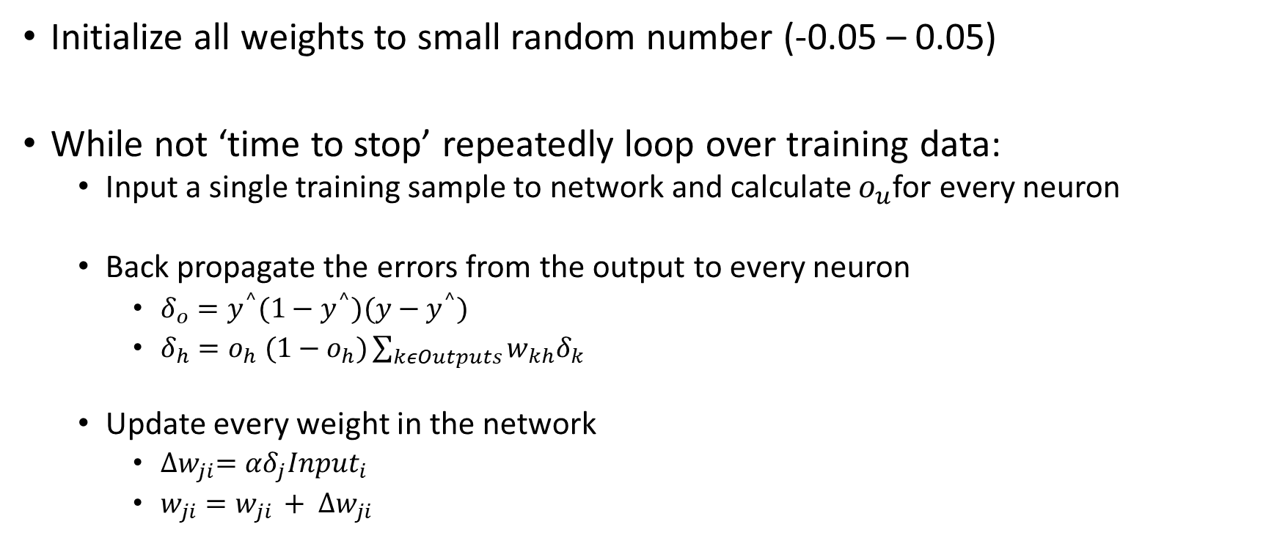
Backprop Algorithm
Initialize all weights to small random number (-0.05 – 0.05)
While not ‘time to stop’ repeatedly loop over training data:
  Input a single training sample to network and calculate $o_{u}$for every neuron
  Back propagate the errors from the output to every neuron
    $δ_{o}=y^{^}(1−y^{^})(y−y^{^})$
    $δ_{h}=o_{h} (1−o_{h})\sum_{kεOutputs}{w_{kh}δ_{k}}$
  Update every weight in the network
    ${∆w}_{ji}=αδ_{j}{Input}_{i}$
    $w_{ji}=w_{ji }+ {∆w}_{ji}$
Downstream error
This node’s effect on error
Stopping Criteria:
# of Epochs (passes through data)
Training set loss stops going down
Accuracy on validation data

Slide 17





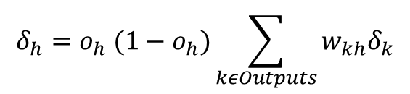



Backprop with Hidden Layer
(or multiple outputs)
Forward Propagation
Back Propagation
Update Weights
$δ_{h1,1}=o_{h1,1} \left(1−o_{h1,1}\right)∗(w_{1,1→2,1}δ_{2,1}$ + $w_{1,1→2,2}δ_{2,2}$)
$$w_{1,1→2,1}$$
$$δ_{h1,1}$$
$$δ_{h2,1}$$
$$w_{1,1→2,2}$$
$$δ_{o}$$
$$x_{1}$$ | 1.0
$$x_{2}$$ | 0.5
$$y$$ | 1
${∆w}_{i}=∝δ_{k}{Input}_{i}$
$$δ_{h1,2}$$
$$δ_{h2,2}$$
$$δ_{o}=y^{^}(1−y^{^})(y−y^{^})$$
$$δ_{h}=o_{h} (1−o_{h})\sum_{kεOutputs}{w_{kh}δ_{k}}$$

Slide 18
Stochastic Gradient Descent
Gradient Descent
  Calculate gradient on all samples
  Step
Stochastic Gradient Descent
  Calculate gradient on some samples
  Step
Stochastic can make progress faster (large training set)
Stochastic takes a less direct path to convergence
Batch Size: N instead of 1
Per Sample Gradient
Gradient Descent
Stochastic
Gradient Descent

Slide 19
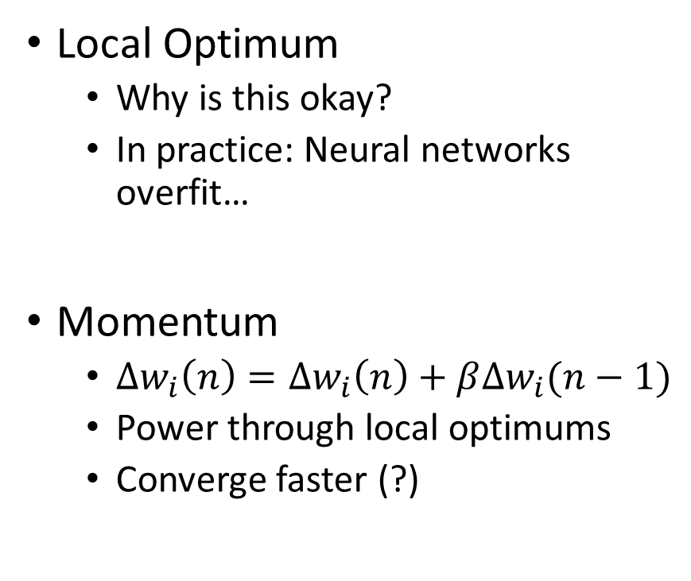
Local Optimum and Momentum
Local Optimum
  Why is this okay?
  In practice: Neural networks overfit…
Momentum
  ${∆w}_{i}\left(n\right)={∆w}_{i}\left(n\right)+β{∆w}_{i}(n−1)$
  Power through local optimums
  Converge faster (?)
Loss
Parameters

Slide 20
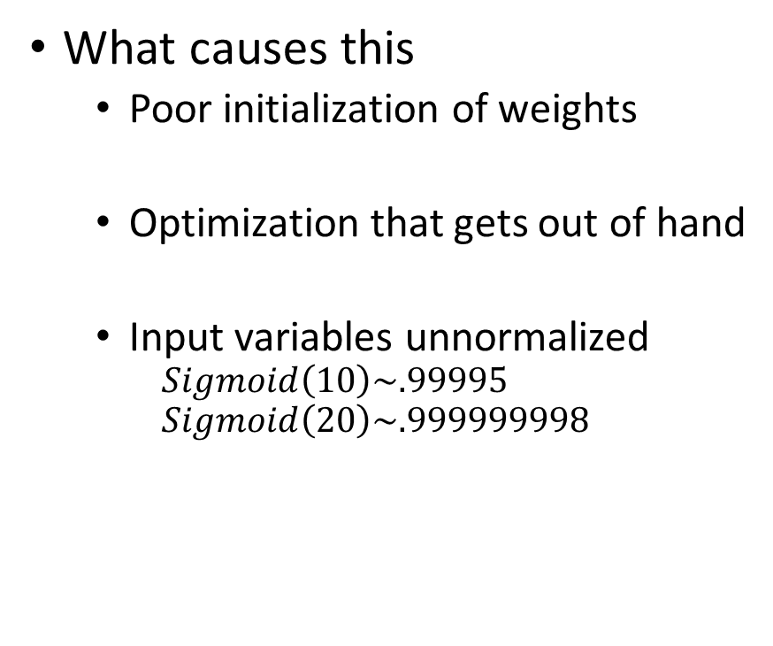
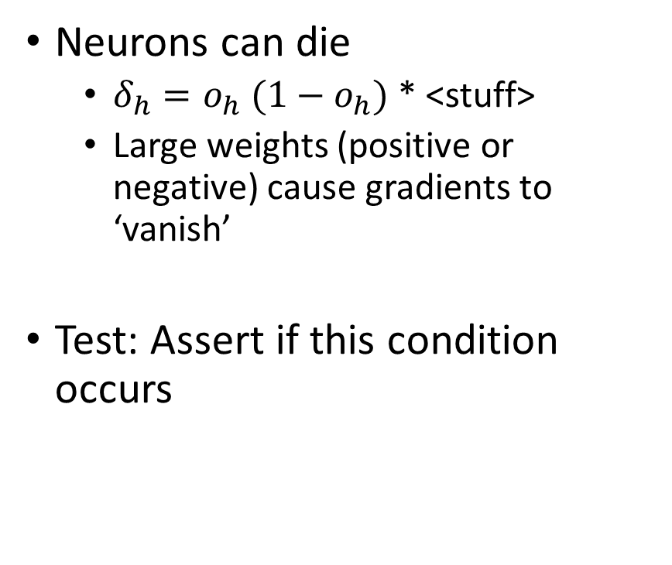
Dead Neurons & Vanishing Gradients
Neurons can die
  $δ_{h}=o_{h} (1−o_{h})$ * <stuff>
  Large weights (positive or negative) cause gradients to ‘vanish’
Test: Assert if this condition occurs
What causes this
  Poor initialization of weights
  Optimization that gets out of hand
  Input variables unnormalized
    $$Sigmoid\left(10\right)\sim .99995$$
    $$Sigmoid\left(20\right)\sim .999999998$$

Slide 21
What should you do with Neural Networks?
As a model (similar to others we’ve learned)
  Fully connected networks
  Few hidden layers (1,2,3)
  A few dozen nodes per hidden layer
Do some feature engineering
  Normalization
Tune parameters
  # layers
  # nodes per layer
Be careful of overfitting
Simplify if not converging
Leveraging recent breakthroughs
  Understand standard architectures
  Get some GPU acceleration
  Get lots of data
Craft a network architecture
  More on this next class

Slide 22
Summary of Artificial Neural Networks
Model that very crudely approximates the way human brains work
Each artificial neuron is a linear model, with non-linear activation function
Neural networks are very expressive, can learn complex concepts (and overfit)
Neural networks learn features (which we might have hand crafted without them)
Many options for network architectures
Backpropagation is a flexible algorithm to learn neural networks

