Slide 1
ML Design Pattern:
Corpus Centric Learning
A Computer Vision System

Slide 2

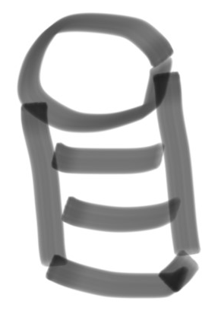
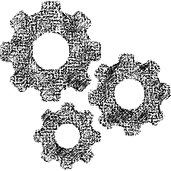

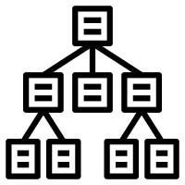

Corpus Centric Learning
Data Collection and Labeling Process
Intelligence Creation Environment
Intelligence Management
Intelligence Runtime
Data Collection
Corpus Centric
Training Corpus
Modeling Process
Data Labeling
Corpus Centric Learning useful When:
Concept is stable
Can’t get data from usage
  Don’t have any users
  Just not practical given application
  Privacy concerns
Need to achieve high quality before initial launch
Limited Telemetry (poor for training)
Disadvantages:
Can be expensive
Labeling not always possible / as good
Not set for automatic ongoing improvement

Slide 3

Case Study: Computer Vision
Potential Capabilities:
Detect People
Identify People
Gesture Recognition
  Stop
  Next
  Select, etc.
Facial Understanding
  Looking
  Talking
  Glasses, etc.
Large collection of models…
Gesture Models
Person
Localizer
Hand Localizer
Recognizer
Sensor and Runtime
Person
Detector
Face Localizer
Face Models

Slide 4
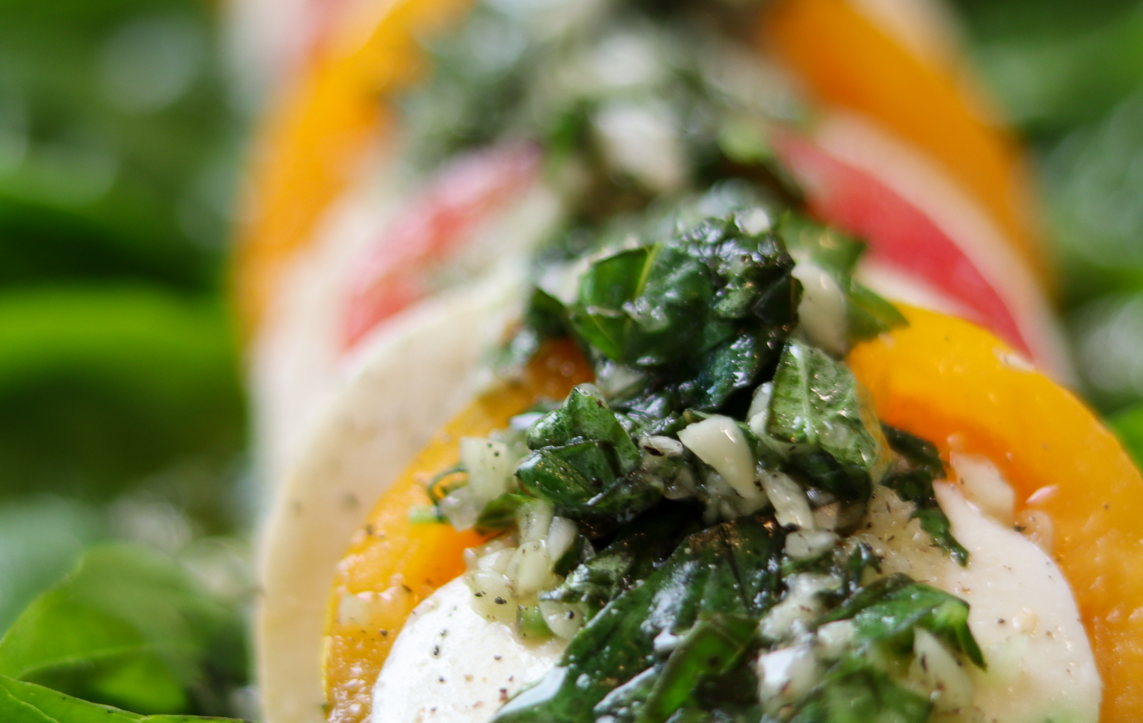

Example of Execution
Launch a thread for detailed processing
Features: Pixels + Localized Points + Orientation
Recognizer
Fast Incremental Localizer
Features: Prev Pixels, Prev Points
Current Pixels
Person
Detector
Person
Localizer
Face Localizer
Face Tracker
Featurizer
NOPE!
Exit
YEP!
Face Models
High efficiency (~several ms per frame)
Features: Shared Featurizer
Properties:
- Lots of models on same data
- Tight coupling between models
- Difficult to ‘close loop’ for labels
- Privacy a serious concern
Normalize:
Scale and Color
Crop / Renormalize
Key Points
Orientation
Reduced Key Points
High efficiency

Slide 5
Getting Data for the Corpus
People working on The Product
  E.g. Devs in front of their computers
  Super biased
    Small Population
    Know how to set it up
    Know what it’s good/bad at
Lab Setting
  E.g. Simulate the environment where it will run, bring in volunteers
  Somewhat biased
    Hard to simulate lots of environments
    Users in labs may not act naturally
In Environment
  E.g. Give to potential users for feedback / training data before launching
  Can yield very good data if the program is run well
    Careful matrix of user types and user environments
    Users configure the system as they want / can
Script
  Collect the situations you want
    Poses
    Gestures
    Activities
  Hard for users to be natural while scripted
  May miss many user activities you didn’t imagine
Using Product as it was intended
  Need enough of the product to be able to use it
  Users may not do the gestures / activities you want
  Users may be so ‘bad’ at the gestures without feedback that the data is useless

Slide 6
Labeling Data
Image (label from scratch)
Frame (incremental update)
Multiple Labelers Per Image
- Track Efficiency
- Crosscheck Accuracy
Massive Labeling Task
Imagenet ~1.2M (human level)
10s of thousands (~getting started)
Workflow, quality checking
Tedious, error prone tasks
Consistency key for success
Data useful for many tasks
Label for several at once
Prepare for future
Tedious job…
But can be fun!
Helping to create an AI
Contributing to a neat product
Lable-o-tron 2072
Complete: 12 / 150,232
x
Next
Agreement Index: 87%
Person 1
Draw bounding box…
Draw face bounding box…
Mark hands…
Annotate face…
Enter properties…
Skin Tone…
Has Glasses…
Wearing Makeup…
Gesture start/end…
1
Image or Video Clip
Add Person
Labels for ‘all’ the models

Slide 7
Training with the Corpus
Train Remaining Models
Coordinate Collection / Labeling
- Ensure no data overlap
Full Pipeline to process training data
Recognizer
Person
Detector
Person
Localizer
Face Localizer
Face Tracker
Featurizer
Face Models
Training Person Detector
Select Train Data / Test Data split
- Ensure same person not in both
- Ensure same location / lab not in both (?)
- Ensure good matrix coverage in both (user types)
Training Person Localizer
Select Train Data / Test Data Split
- Not used to train upstream models (or too optimistic)
- Different users from the ones used up stream, etc
Run data through upstream models / processing
- Only train on images that pass through filters
- Train with correct upstream normalization and labels
Corpus

Slide 8
Evaluating this Model/Data Architecture
Challenges
Keeping the data straight
  Don’t train with extra info / advantages you won’t have at runtime
Coupling between models
  Shipping a new ‘upstream’ model requires training (and testing) all downstream models
  Core changes (e.g. normalization) may have tradeoffs across stack
Retraining the models
  May take many hours (days) to reprocess raw data and retrain complex models
  End-to-end could take weeks
Advantages
Scaling to Teams
  Each model can be managed / optimized by a different group of people
Efficiency at Execution
  Models can be turned on or off in fine grain per scenario
  Features can be highly curated and shared
Value of Data asset can Transcend Application
  Labeling for future growth
  Assuming sensors don’t change too much…

Slide 9
Verifying Model Quality
FPR = 10.1%
Set operating points
  Set threshold for worst case, not average case
  Tune UX for worst case
Per subgroup quality bar
  Per subgroup measure FN at target FP
  Ensure worst FNR at worst FPR is acceptable
Finding risks
  Explore mistakes with a critical eye
  Imagine the worst thing that could happen
  Set up reporting and prepare to react
FPR = 0.1%
Skin Tone
Makeup
Age < 13
Glasses
Backlight
Core Userbase
Something you never thought of…

Slide 10
Evolving a Corpus Based System
Model Change affects Scenario success
- New mistakes
- Control forcefulness / frequency
- Joint release to manage coupling
Model Change affects Scenario success
- Break 3rd party scenarios (?)
- Ongoing cost to 3rd parties
- Or maybe 3rd parties don’t care…
Model Collection
1st Party Scenarios
3rd Party Scenarios
API
Return the minimum info needed (quantize)
> Don’t expose raw probabilities:
- Always use threshold, keep consistent over time
- May use small set of thresholds for different confidence levels
> Don’t expose raw locations:
- Instead of per-pixel location use lower resolution grid
- Hide jitter via API (don’t make 3rd party smooth)
Versioning
> Depending on whose budget the models run in

Slide 11
Summary of Corpus Based Learning
When you can collect data
  Stable Concepts
  [ Can be combined with closed loop ]
When you have to collect data
  No implicit labels possible
  Privacy a key concern
  Bootstrap a system’s quality
Data collection & Labeling are key to success – manage & invest in them
Other Learnings:
Model coupling must be managed
  Complexity in development
  Advantages in efficiency and team
Verifying machine learning systems requires drilling into subpopulations
Think about evolution and how you want to encapsulate information

